Slide 1
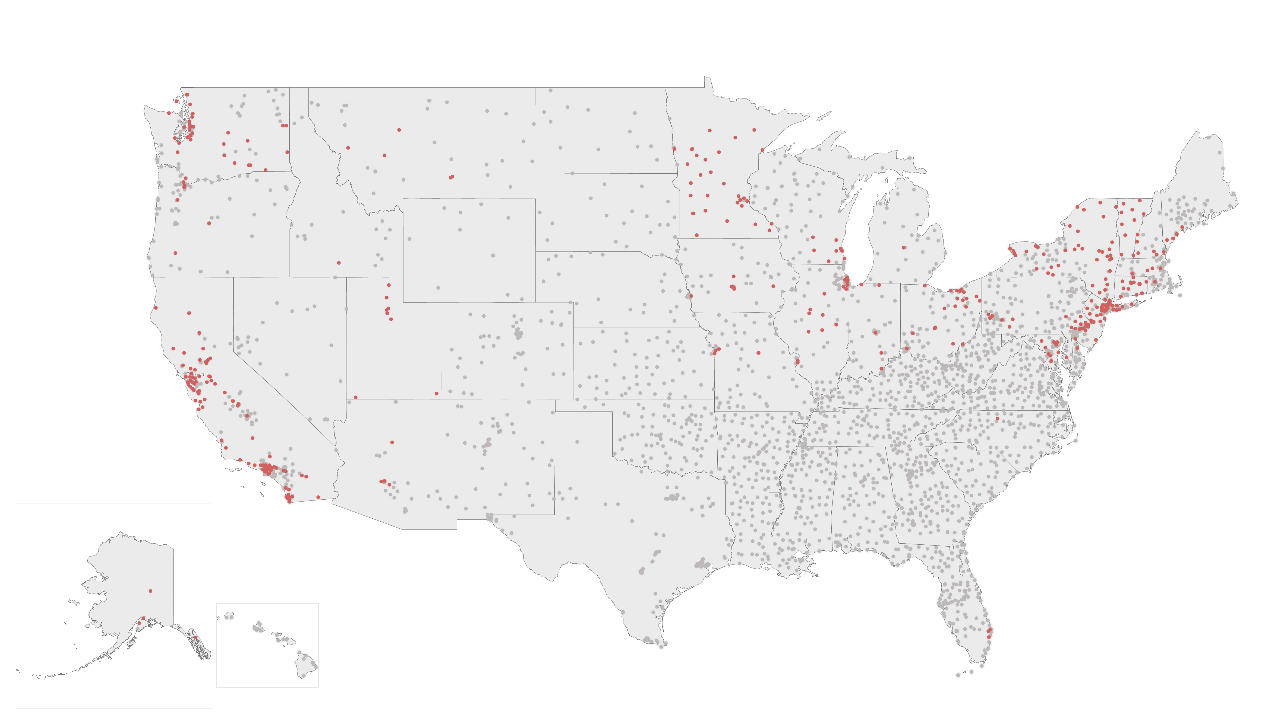
Planned Parenthood Sites and Grantees Withdrawing from Title X Program If Court Does Not Block New Regulations
Title X Sites
Planned Parenthood Title X Sites & Grantees
If the 9th Circuit Federal Court of Appeals does not block the Trump Administration’s Title X family planning regulation, Planned Parenthood sites and grantees will withdraw from the Title X program on August 19, 2019.
NOTES: Map includes 4,024 Title X sites & subrecipients, of which 449 are Planned Parenthoods.
SOURCE: Kaiser Family Foundation analysis of Office of Population Affairs’ Title X Family Planning Directory, June 2019.

