Slide 1

2018 Employer Health Benefits Survey
Release Slides
October 3, 2018

Slide 2
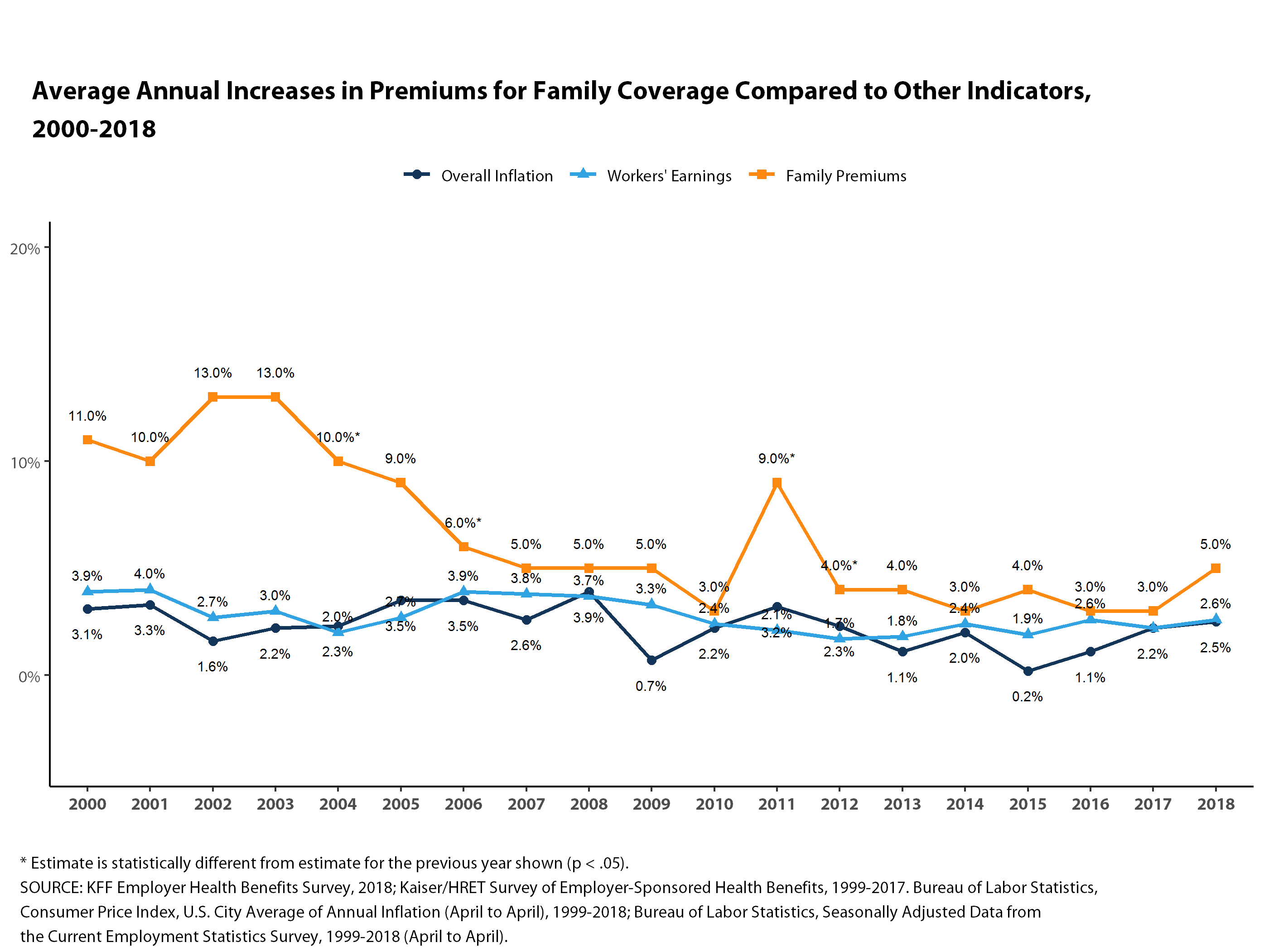

Figure 1

Slide 3
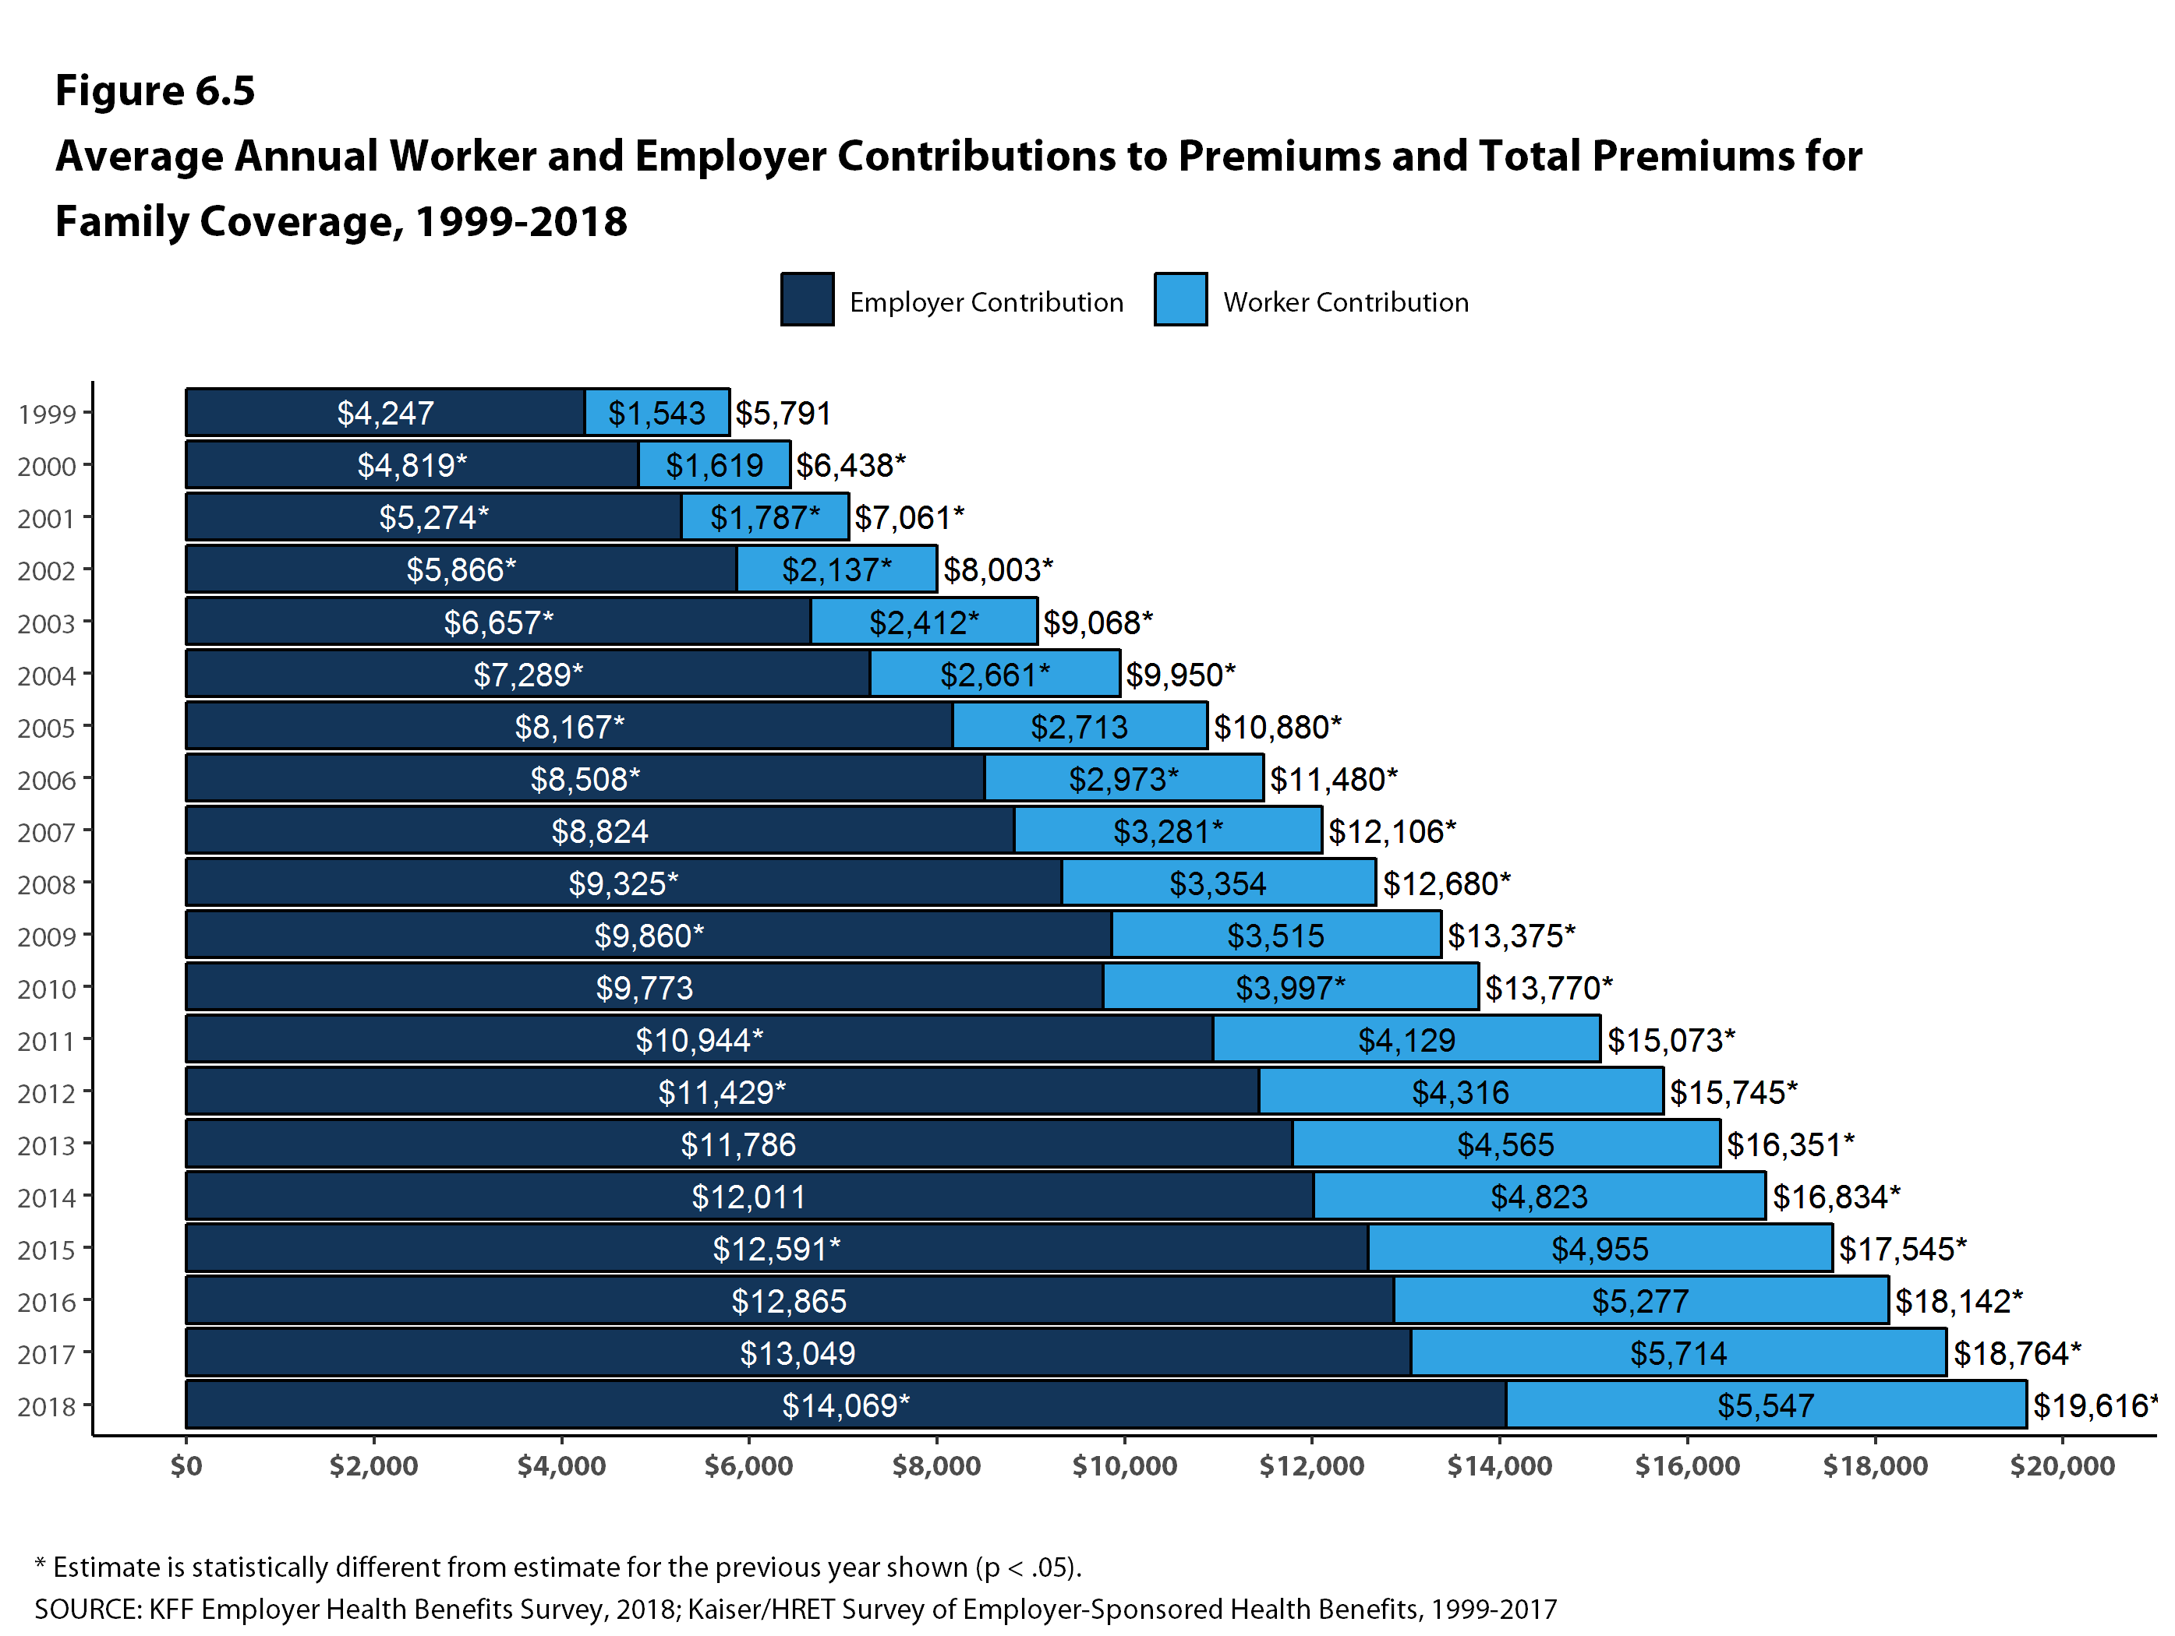
Figure 2

Slide 4
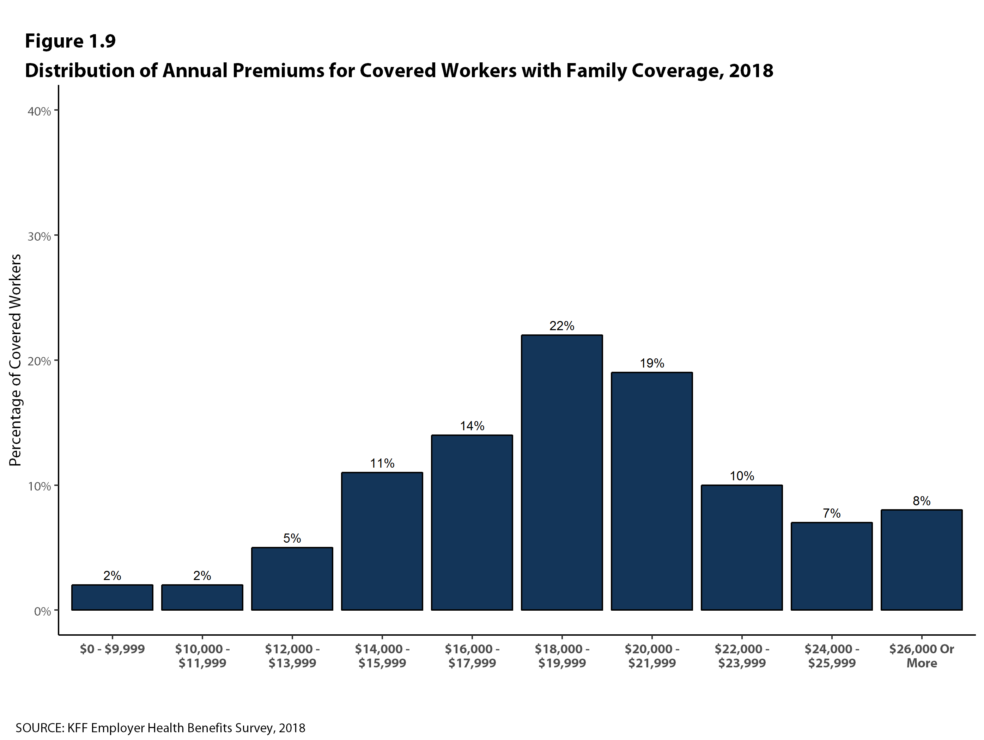
Figure 3

Slide 5
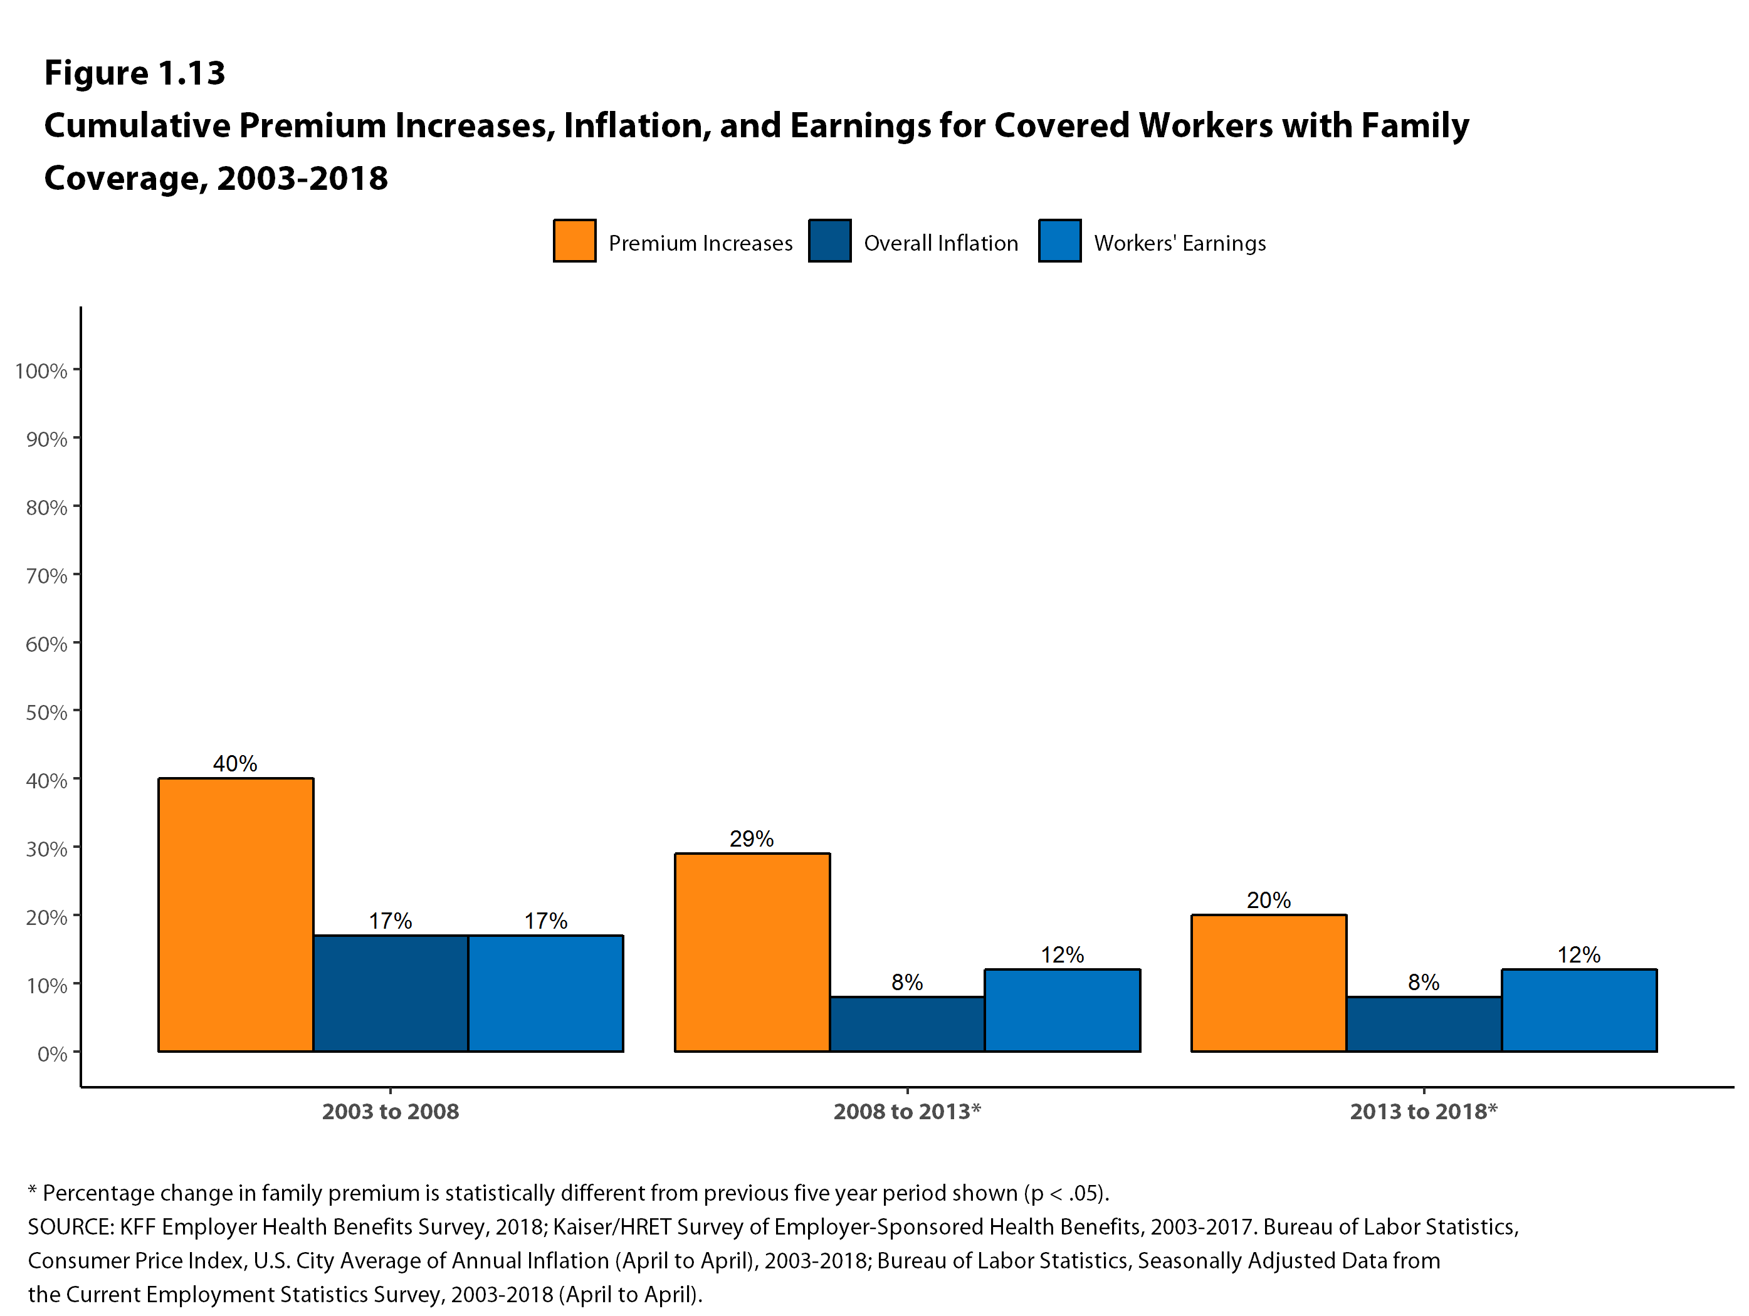
Figure 4

Slide 6
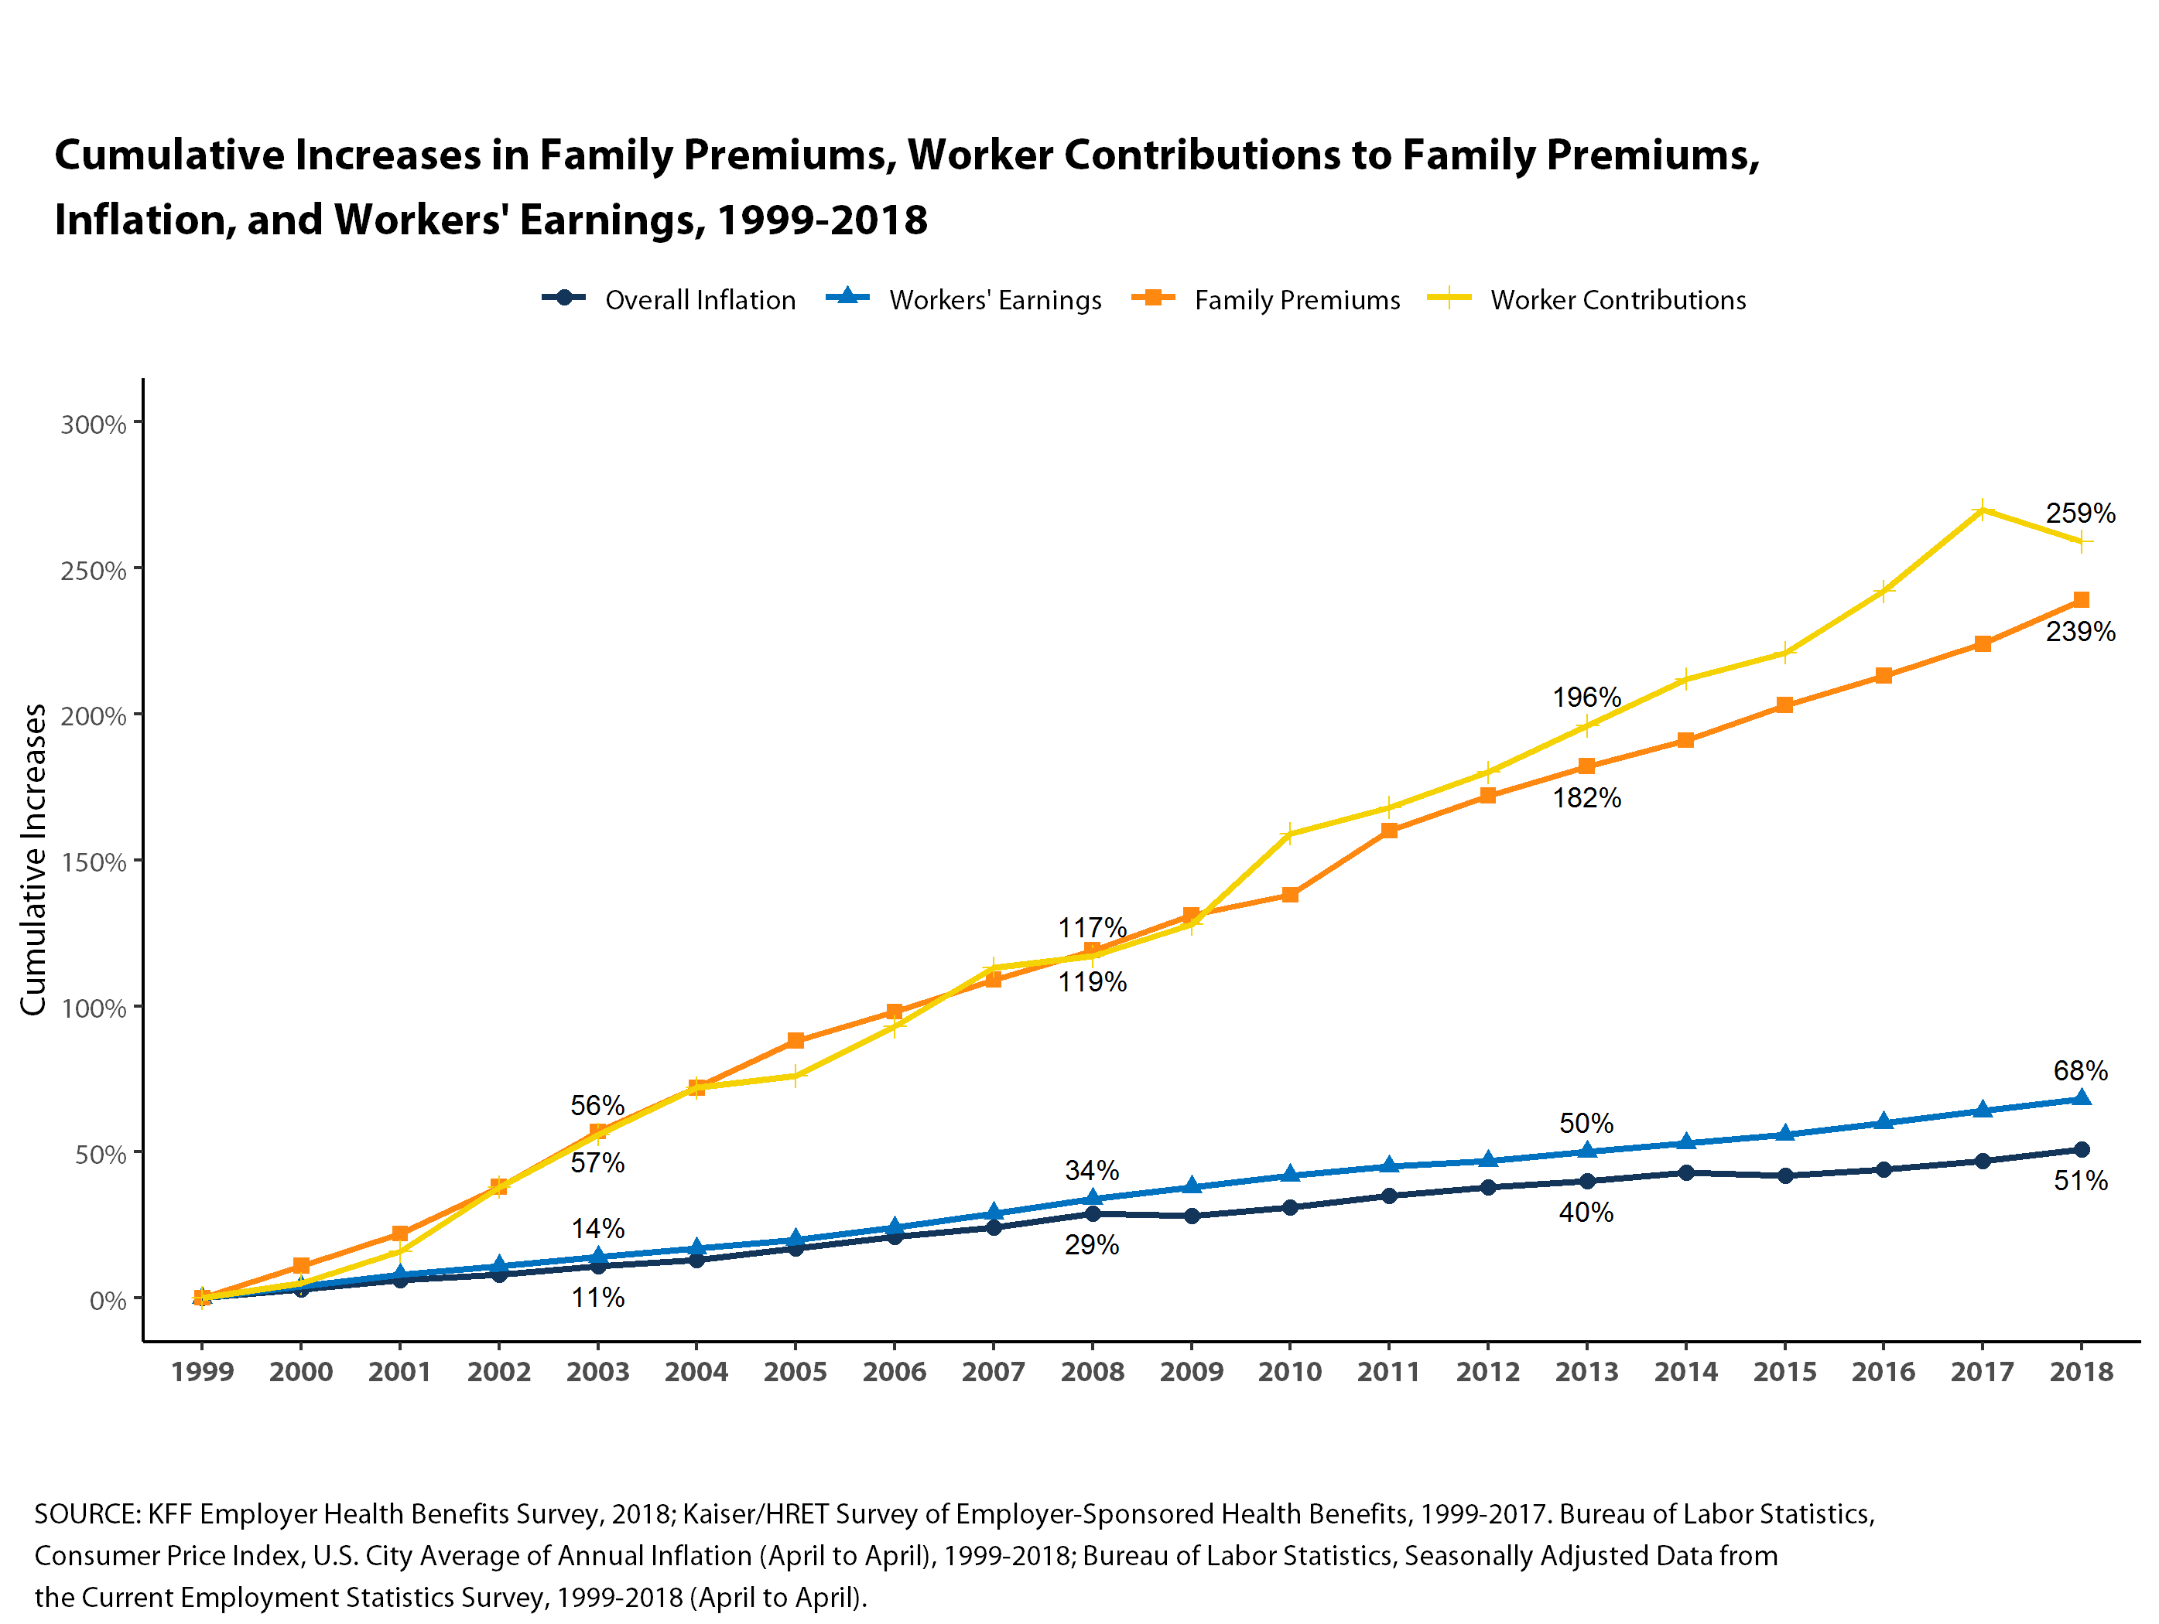
Figure 5

Slide 7
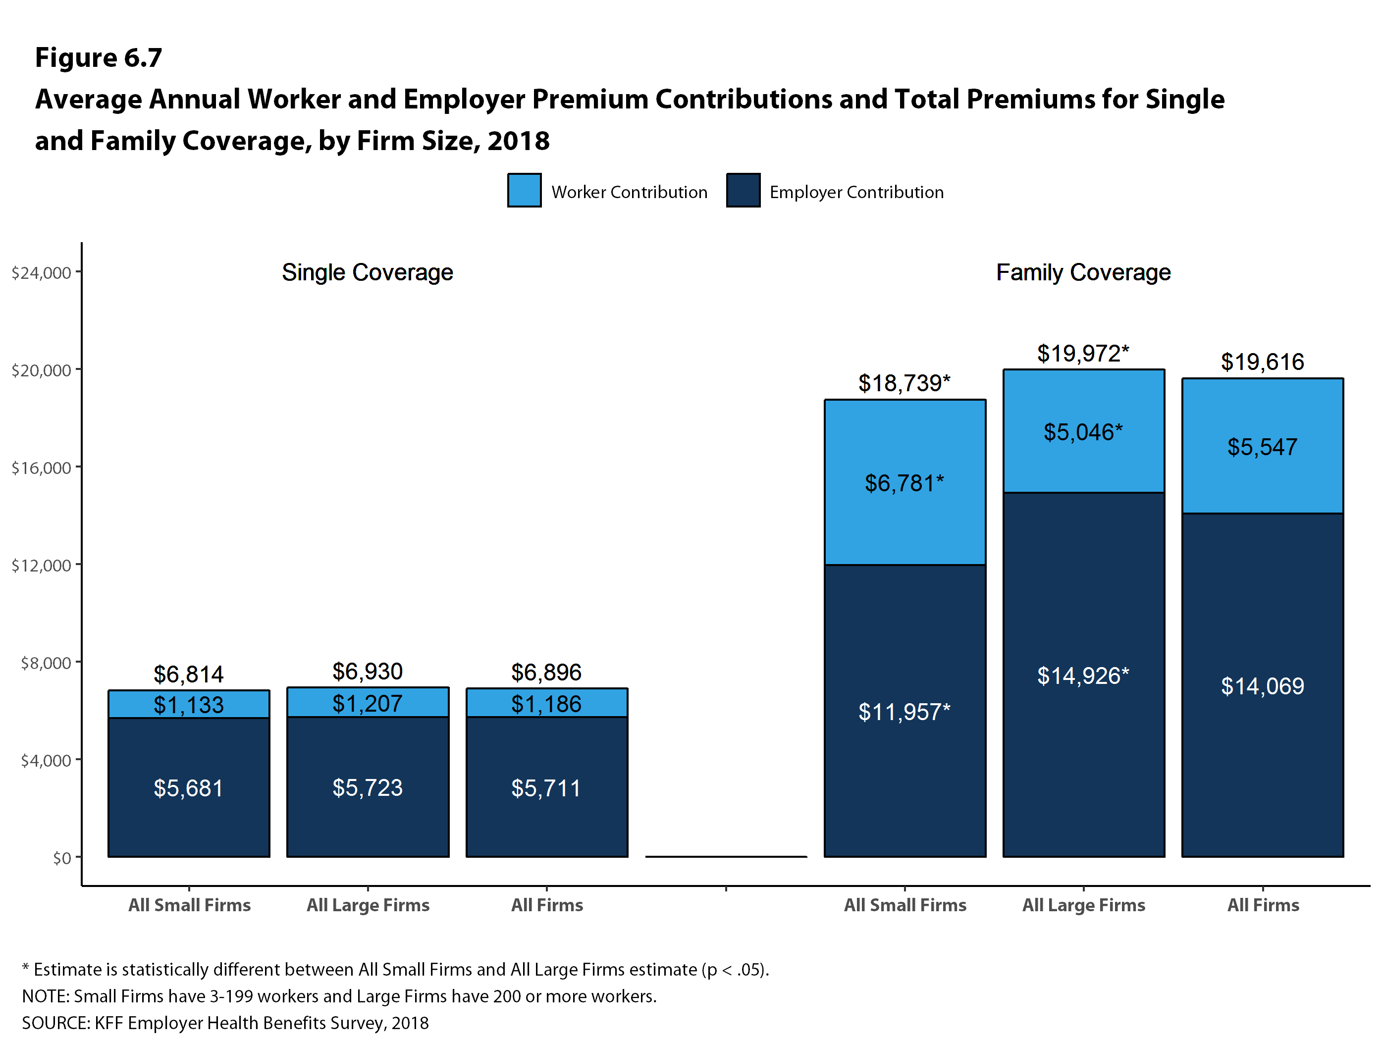
Figure 6

Slide 8
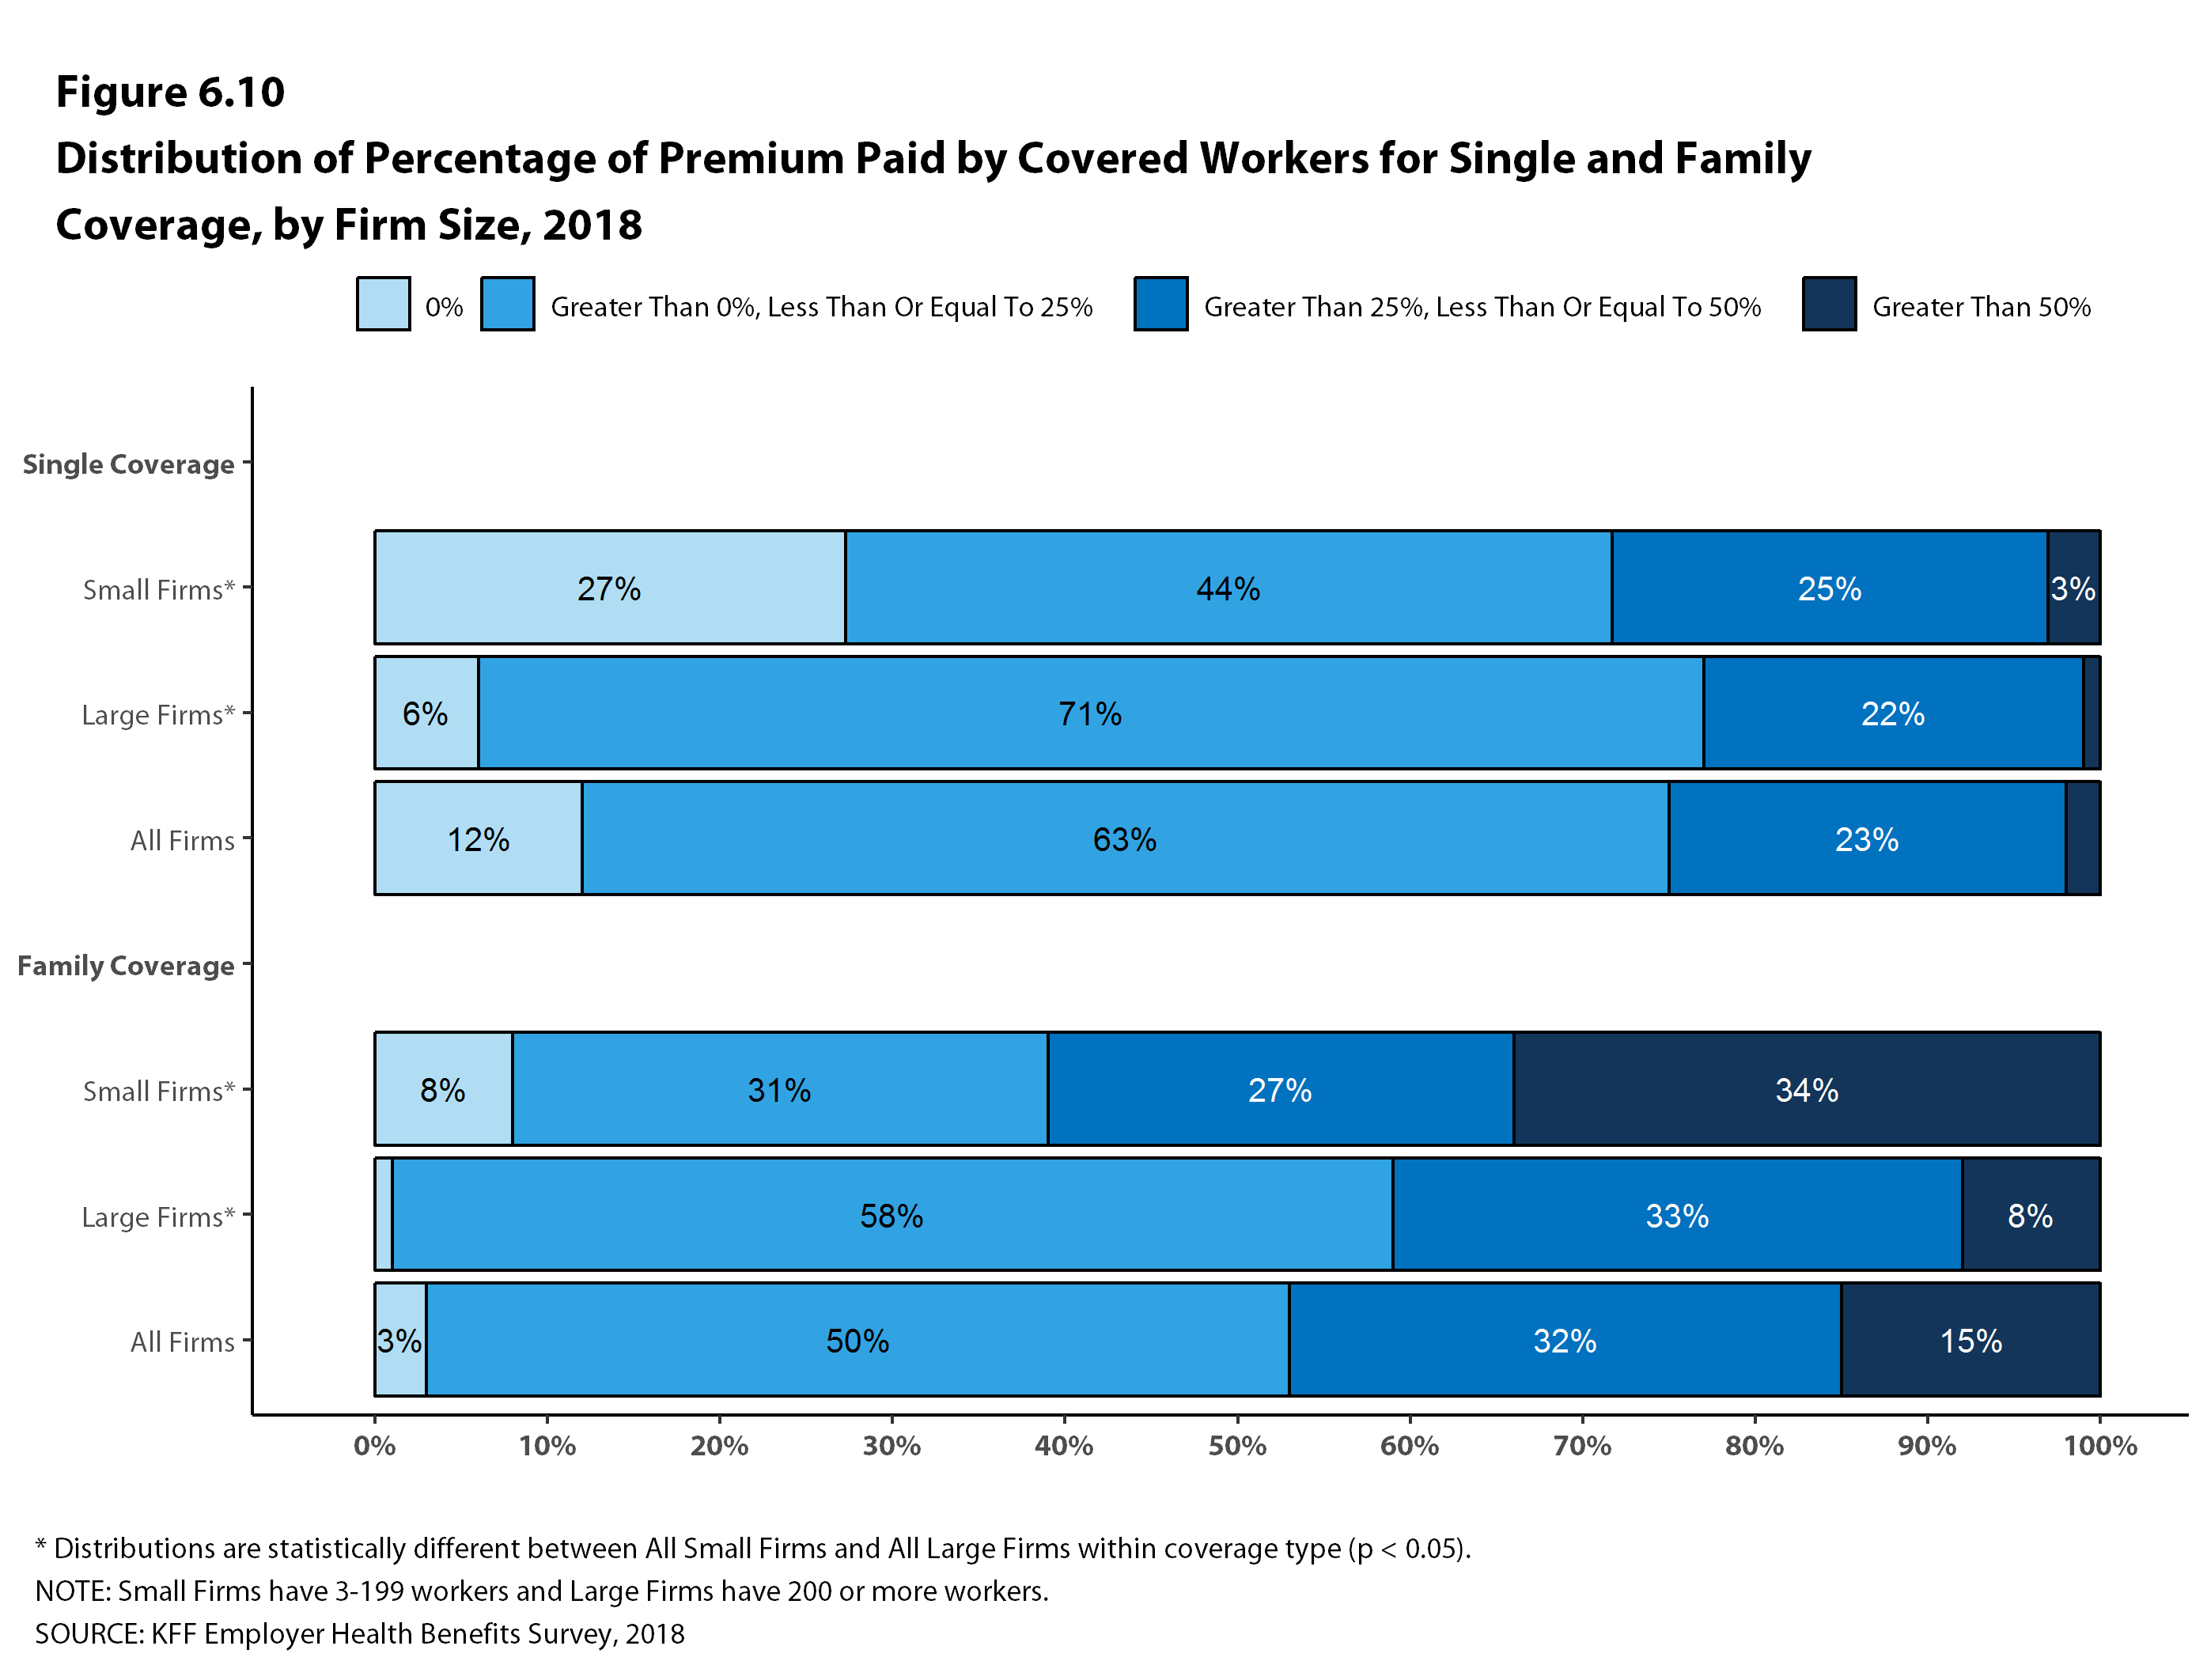
Figure 7

Slide 9
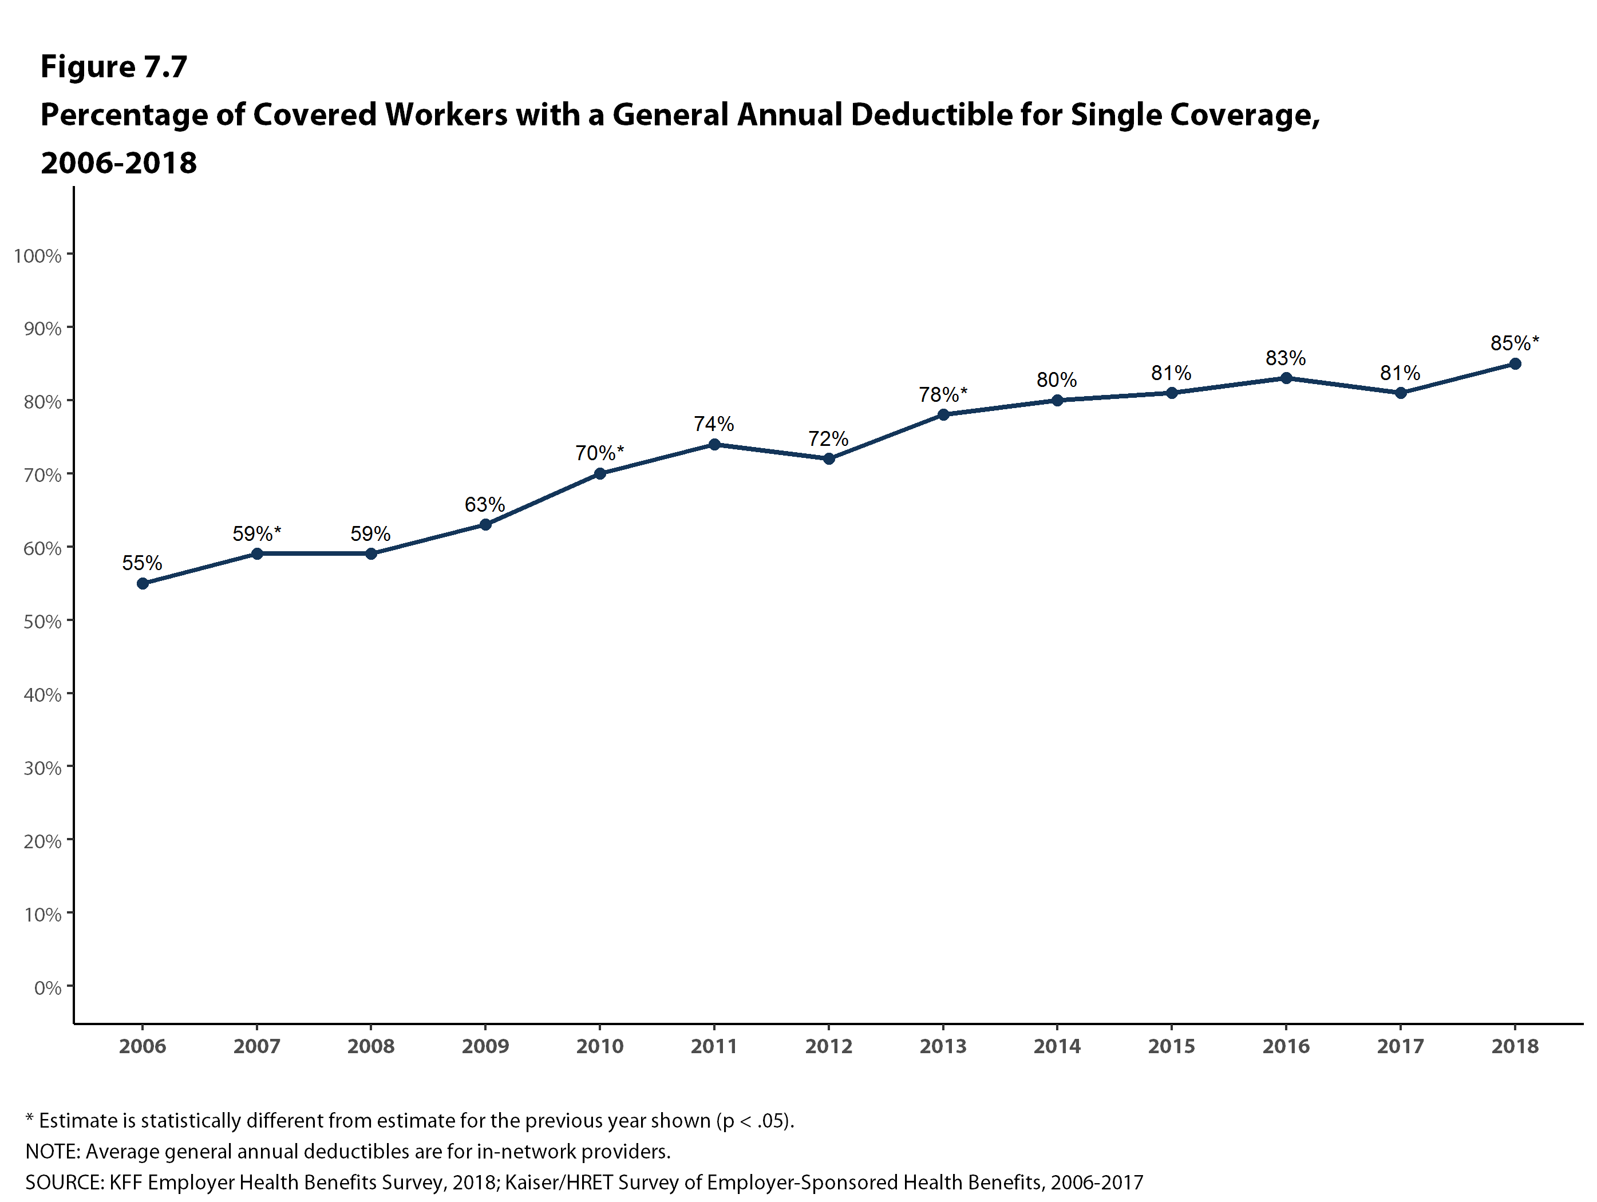
Figure 8

Slide 10
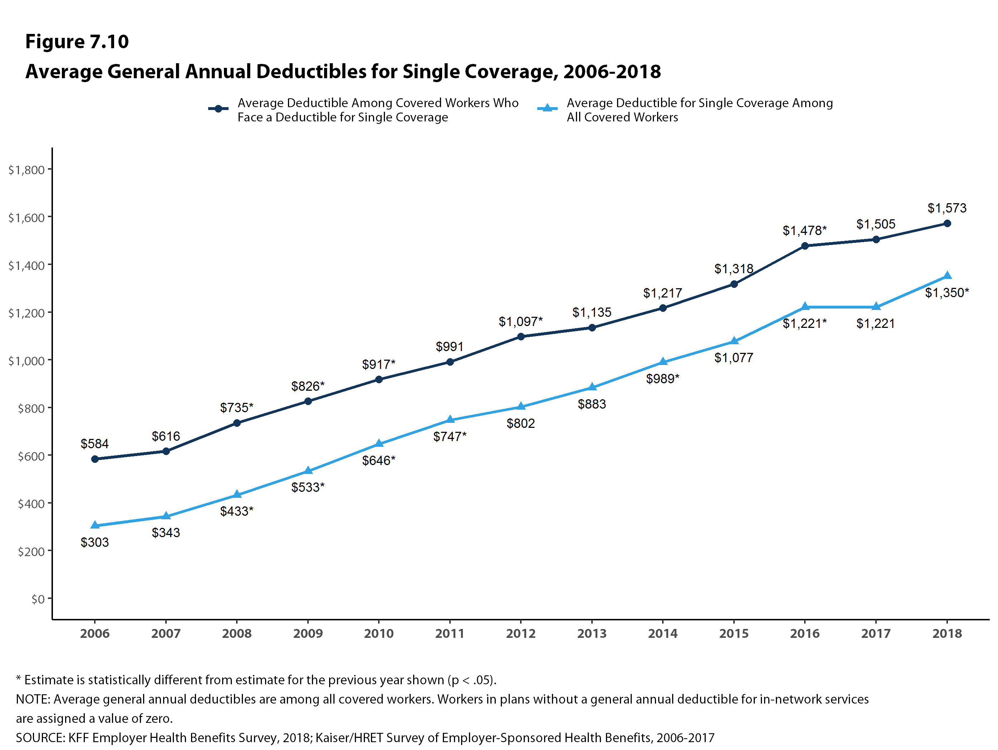
Figure 9

Slide 11
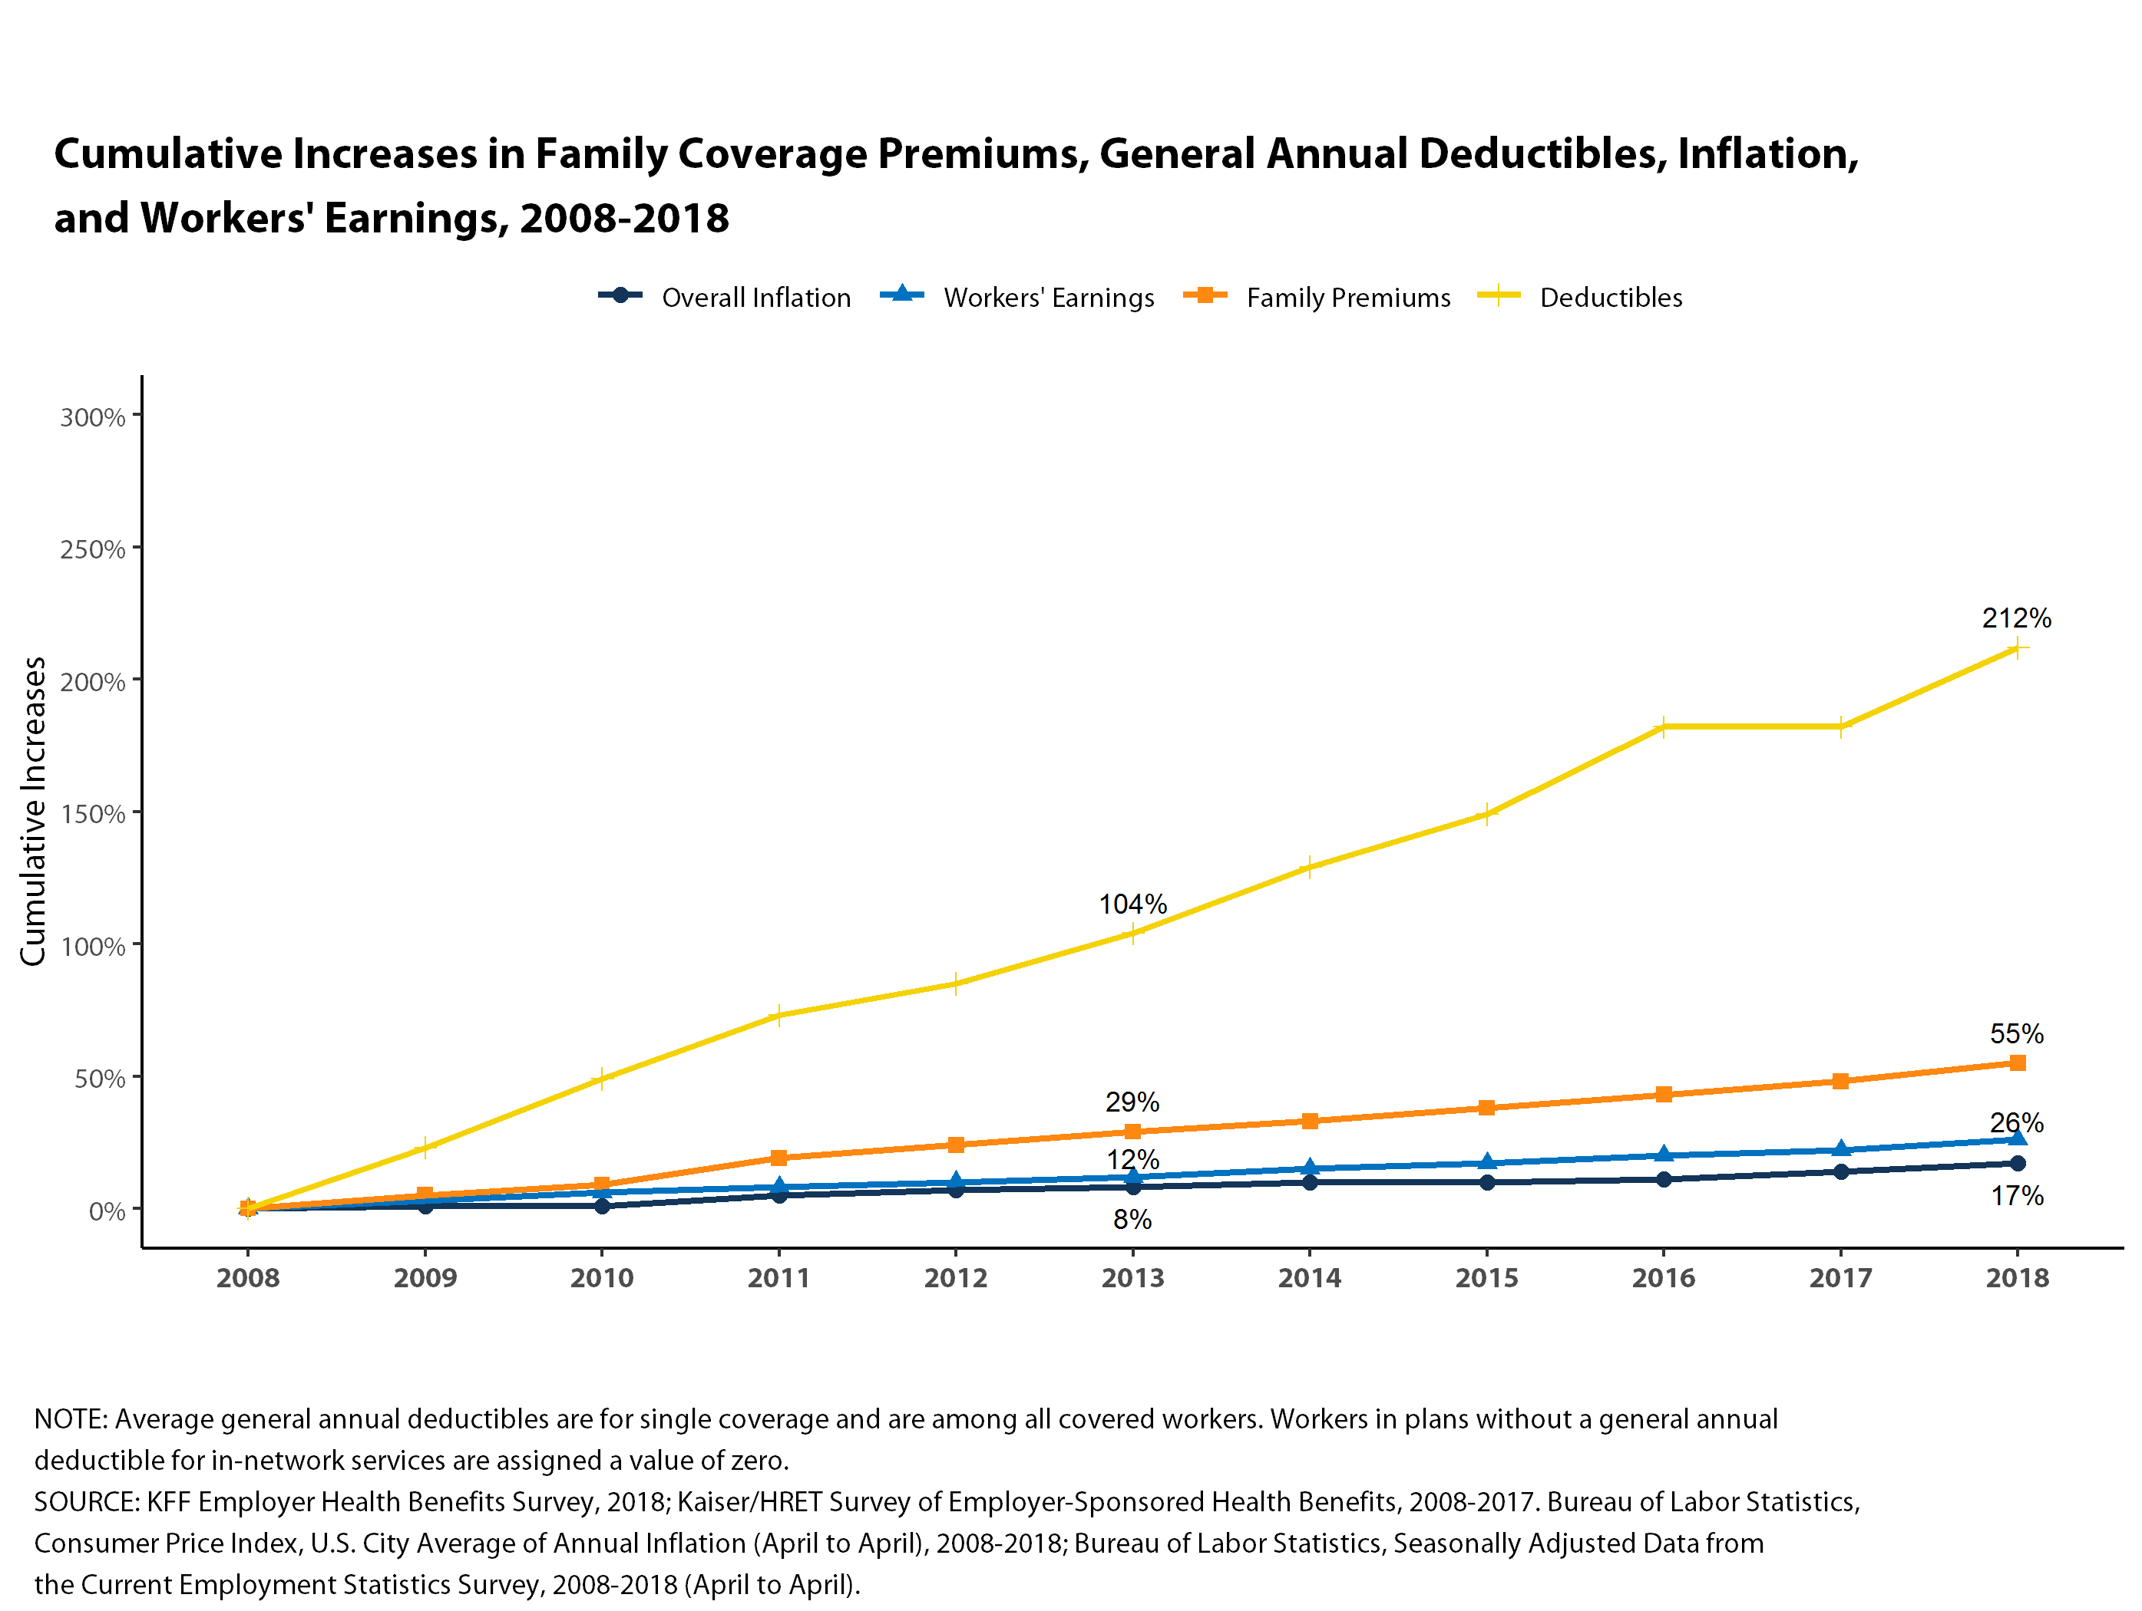
Figure 10

Slide 12
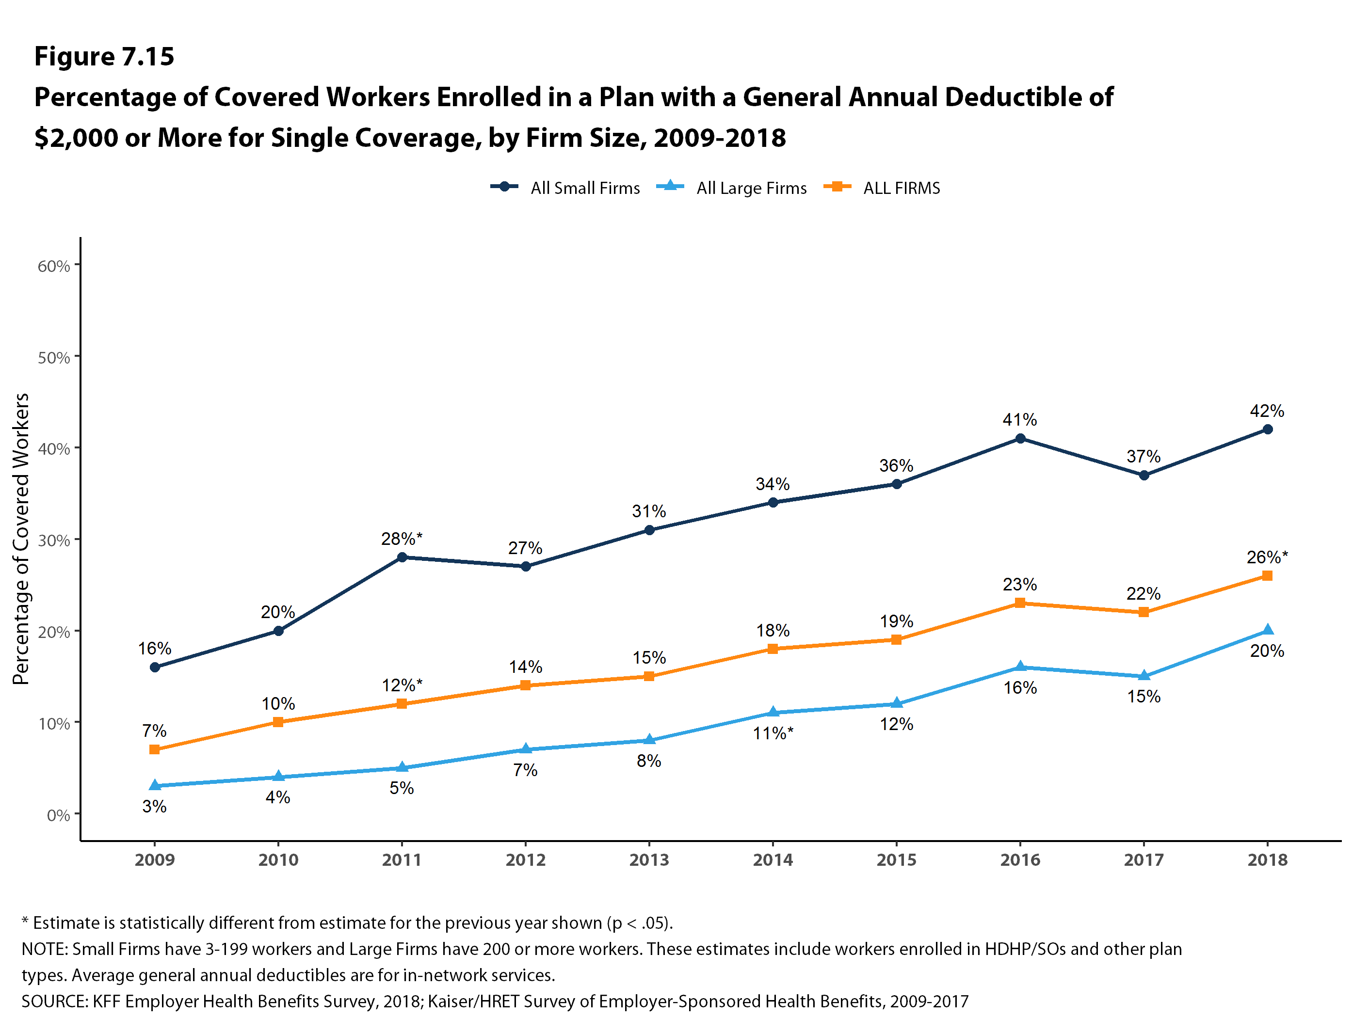
Figure 11

Slide 13
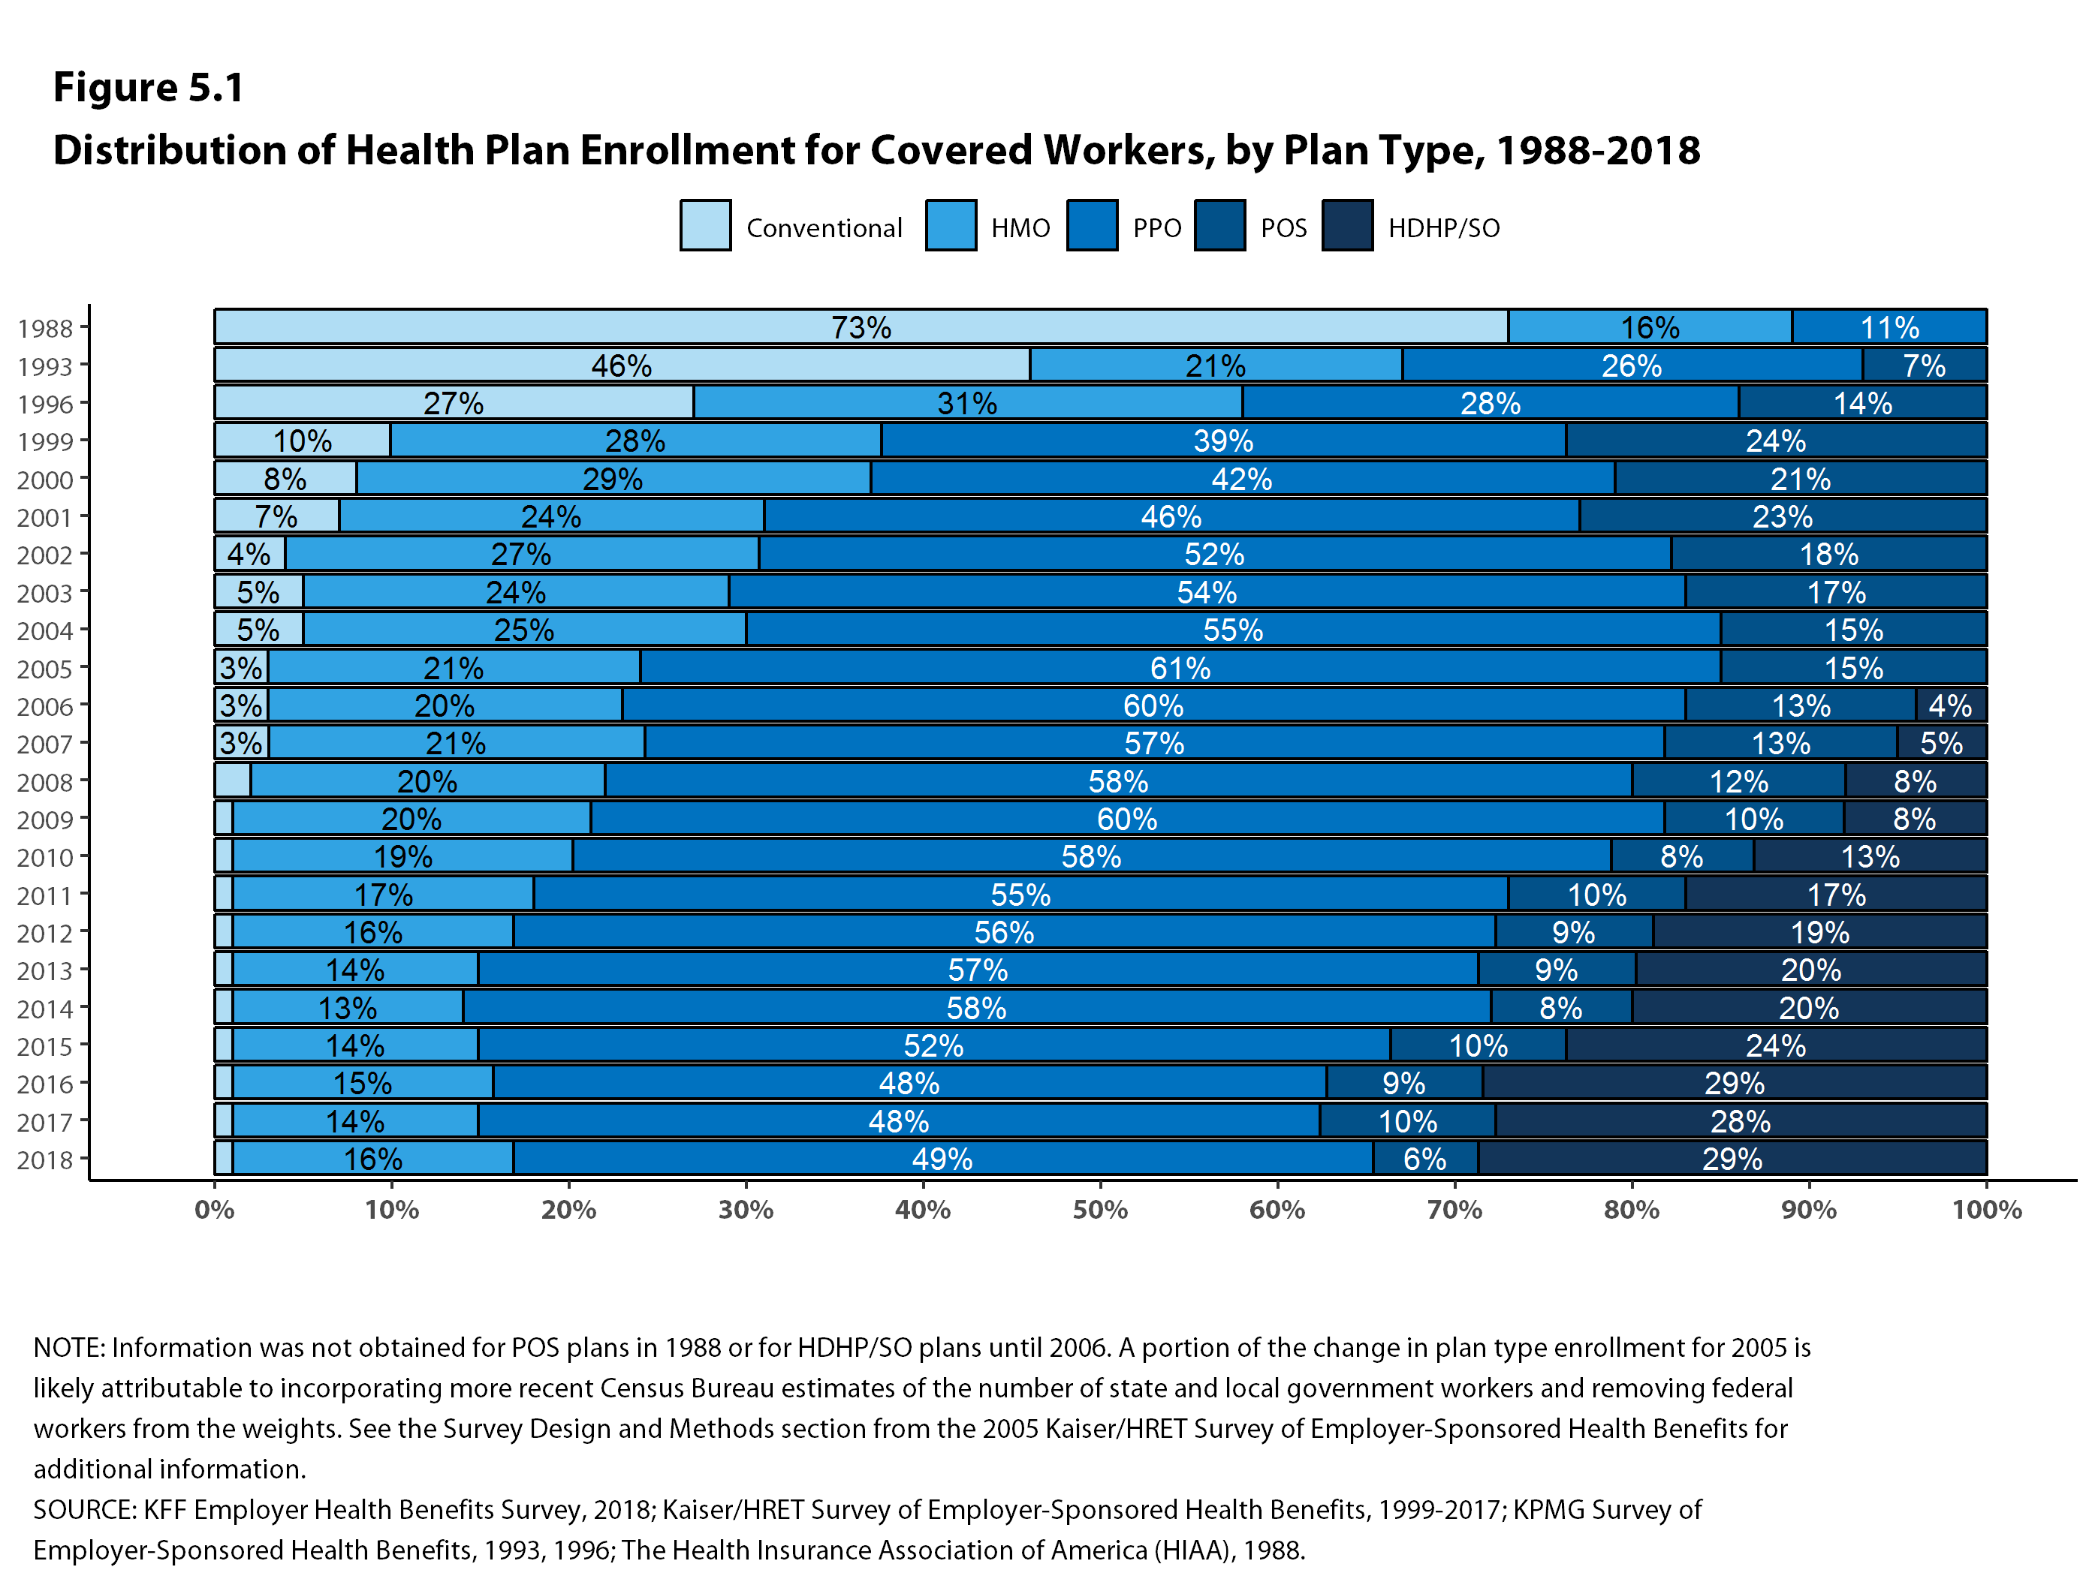
Figure 19
Figure 12

Slide 14
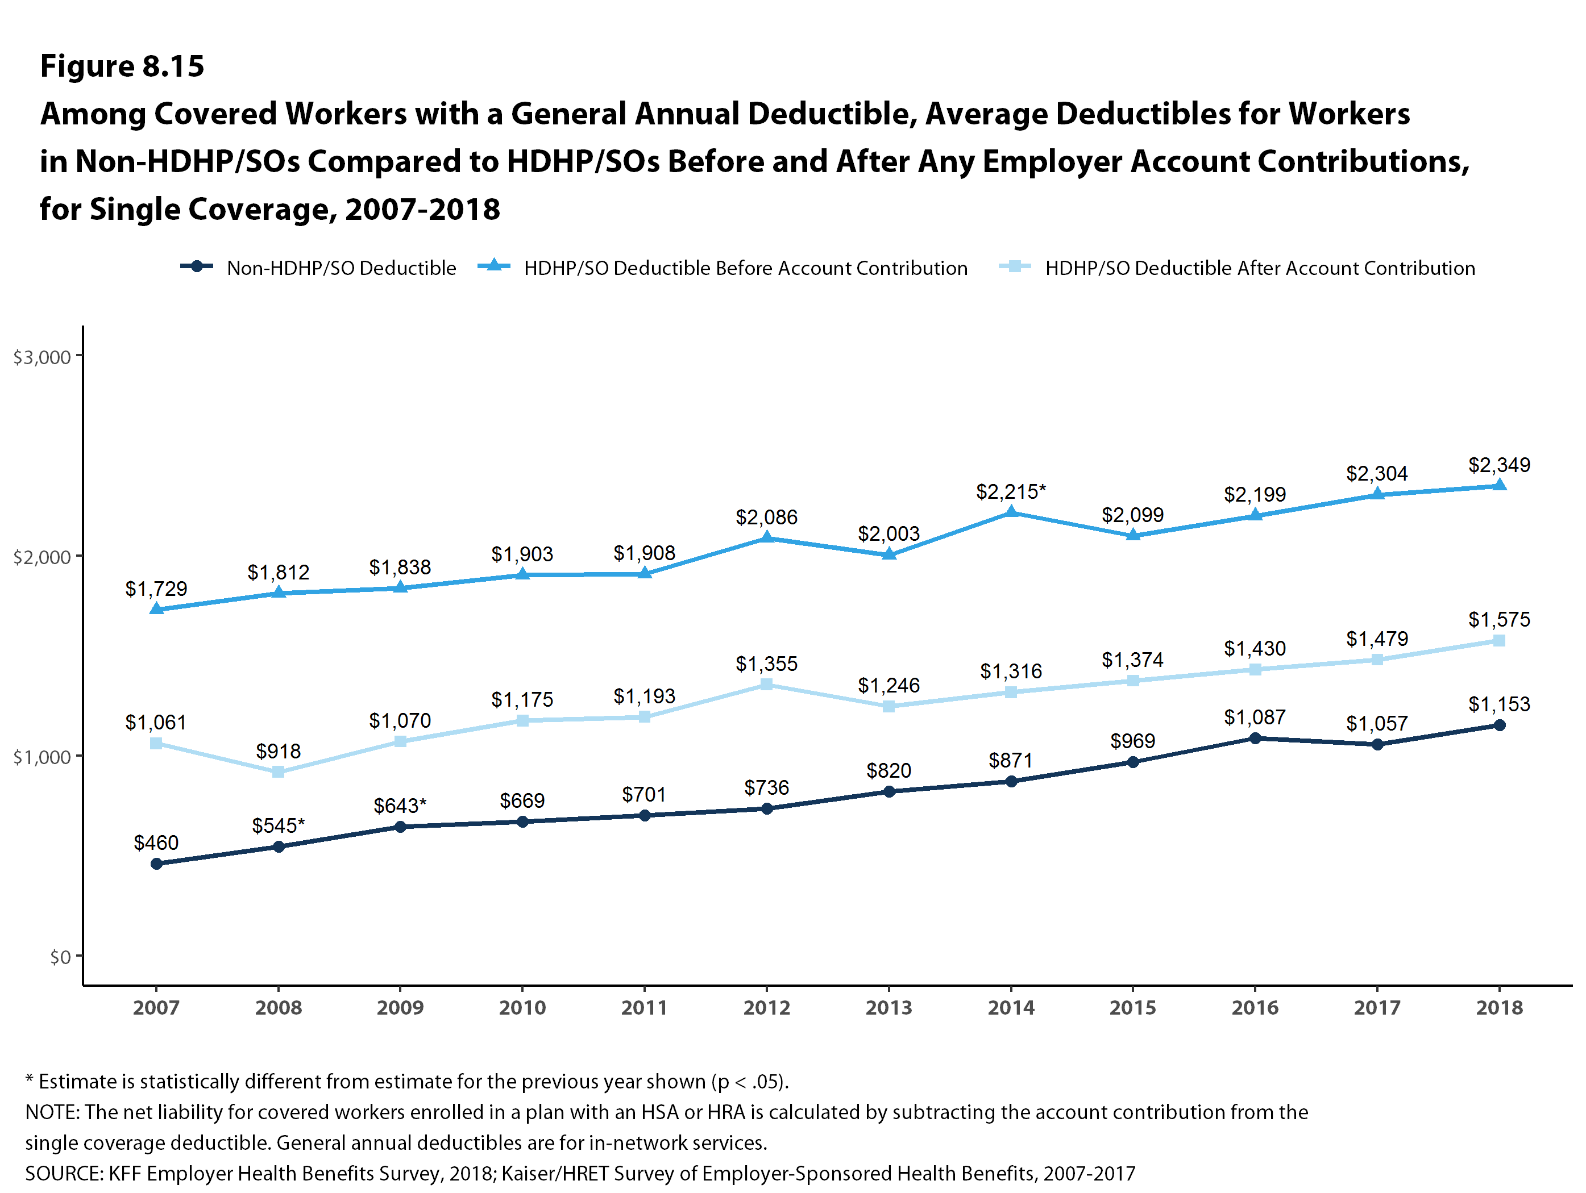
Figure 22
Figure 13

Slide 15
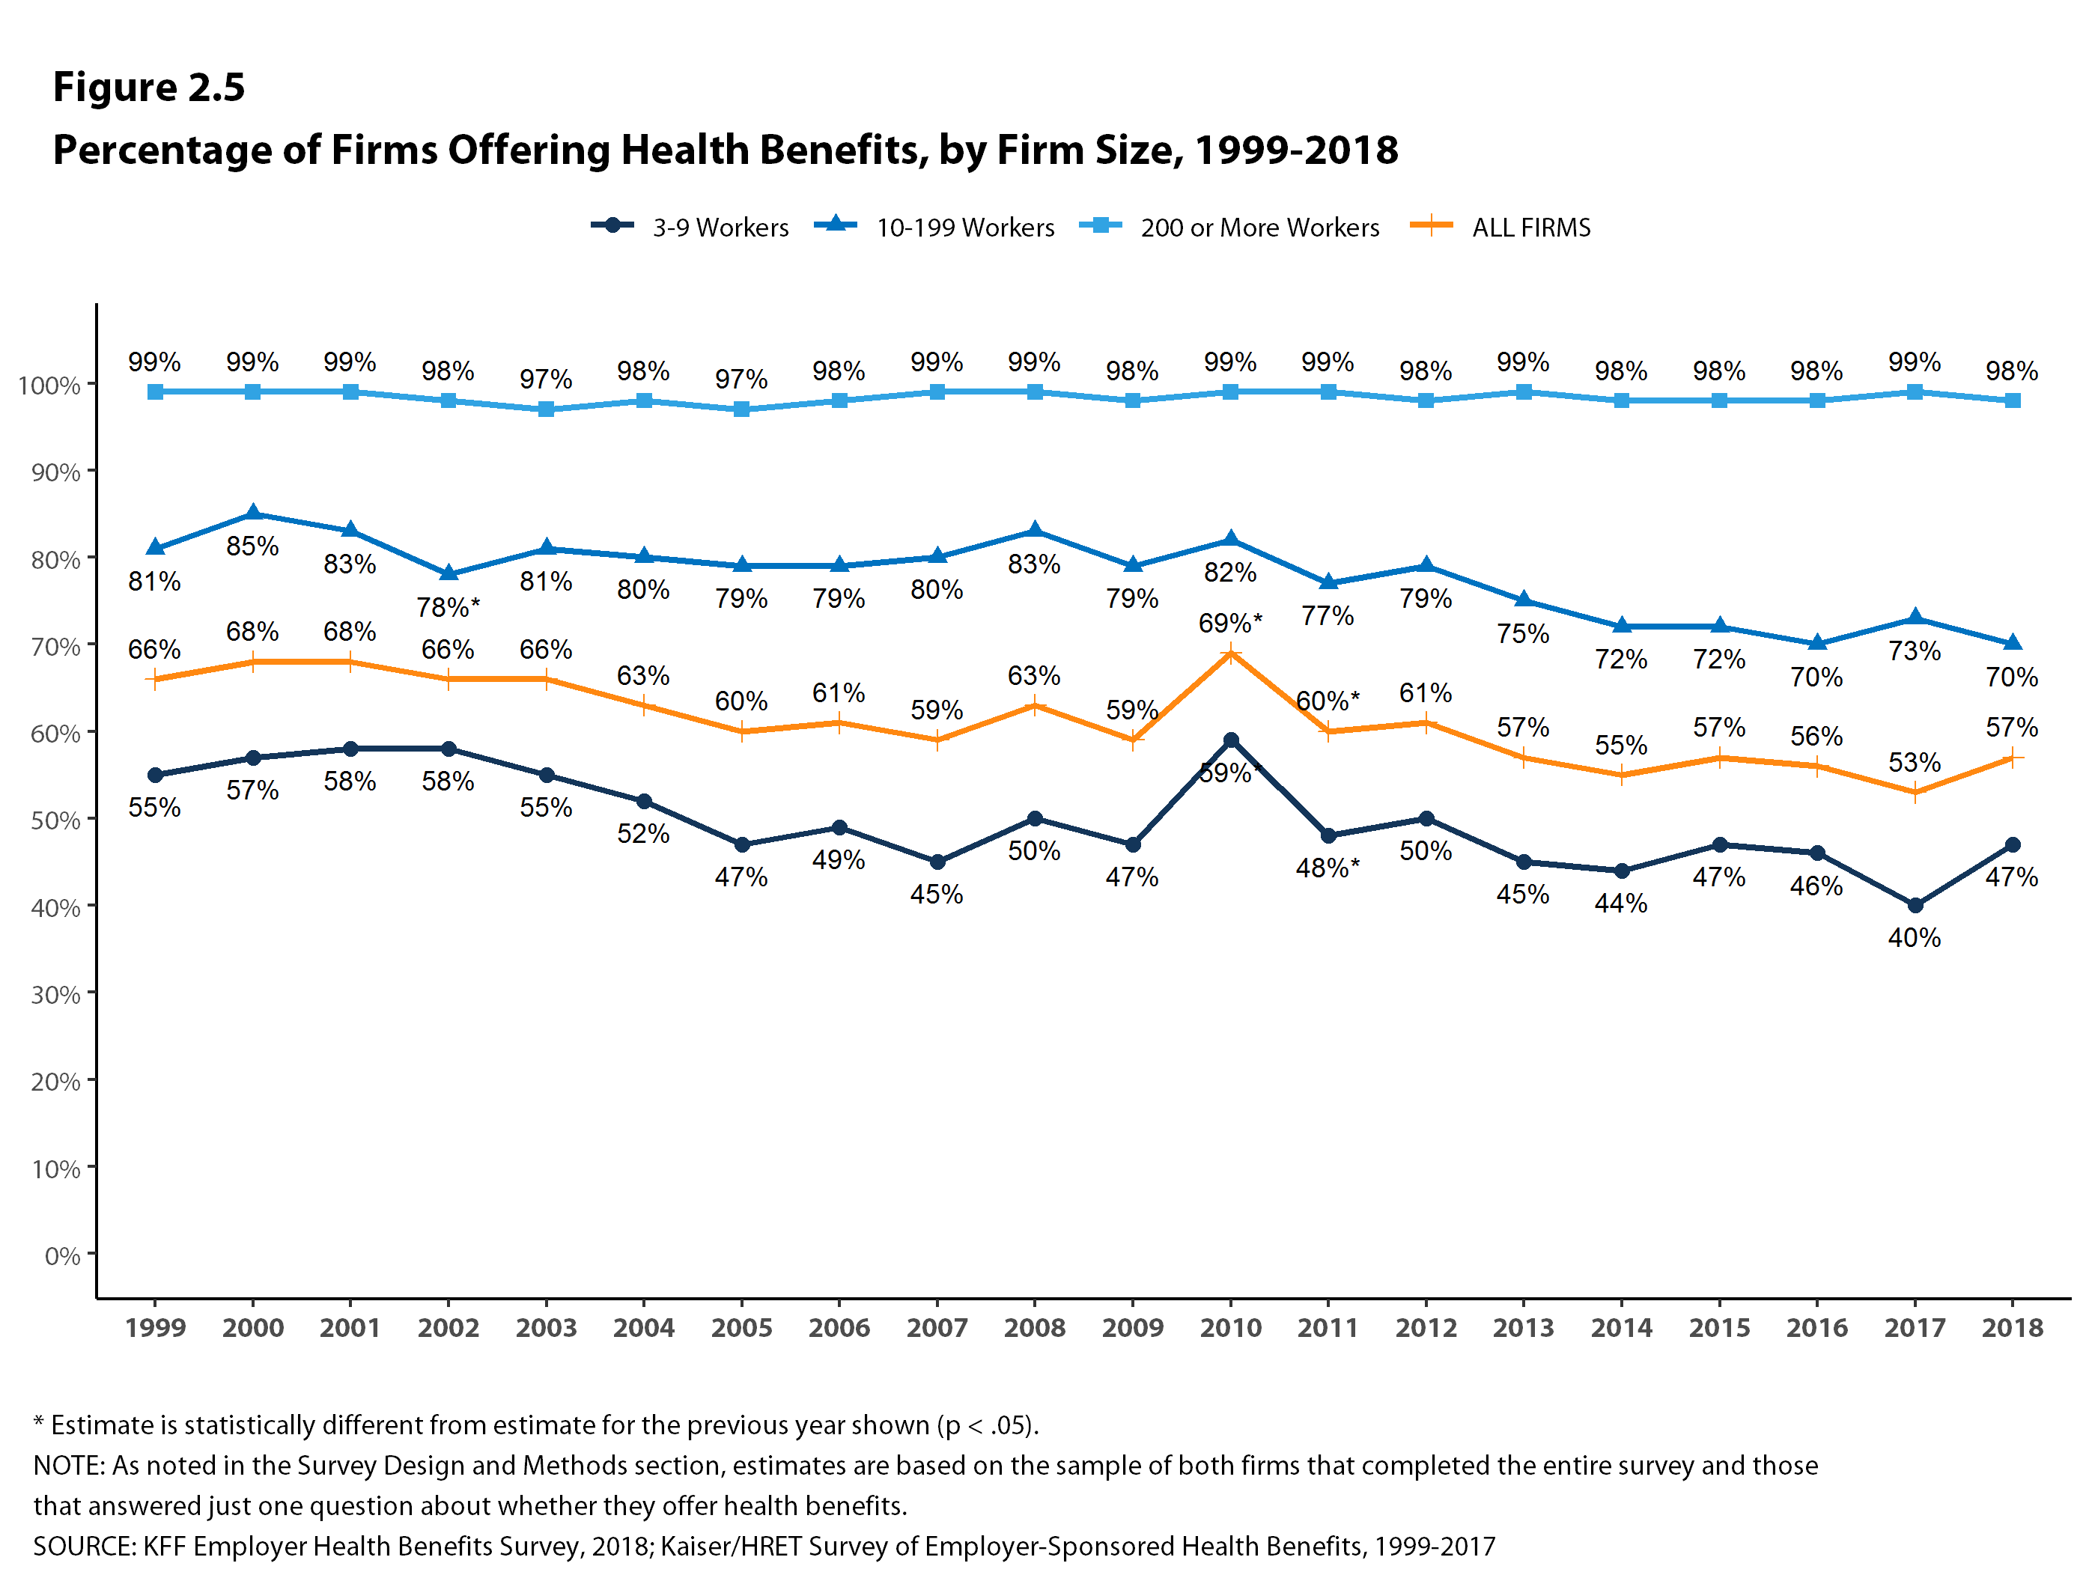
Figure 14

Slide 16
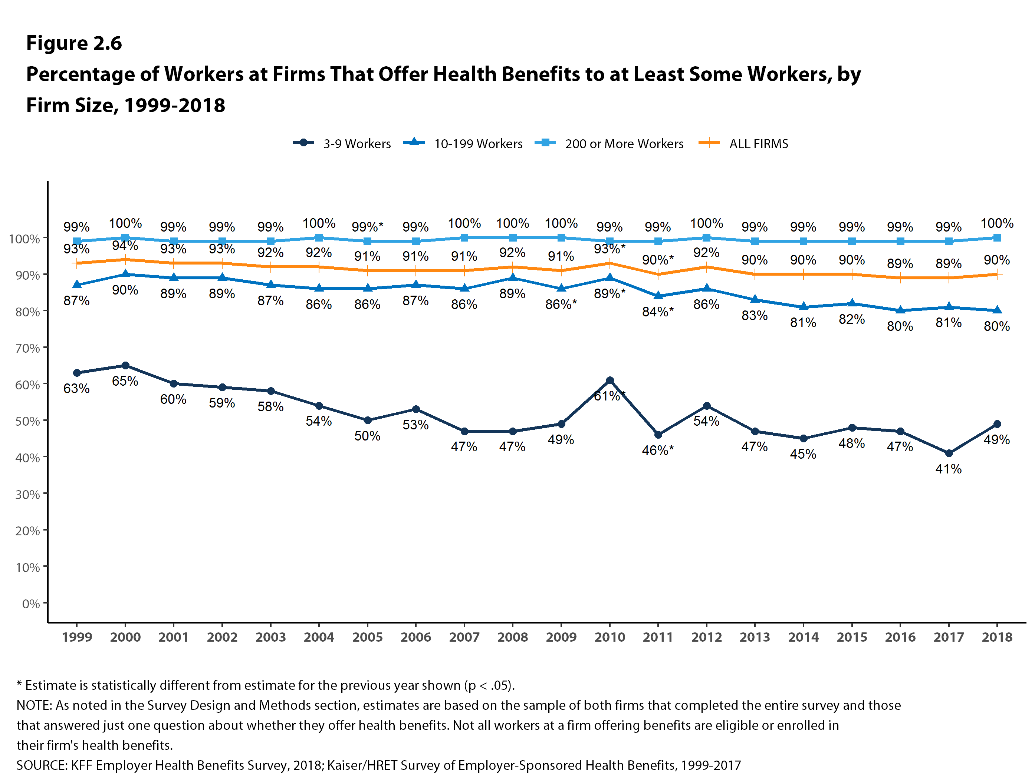
Figure 15

Slide 17
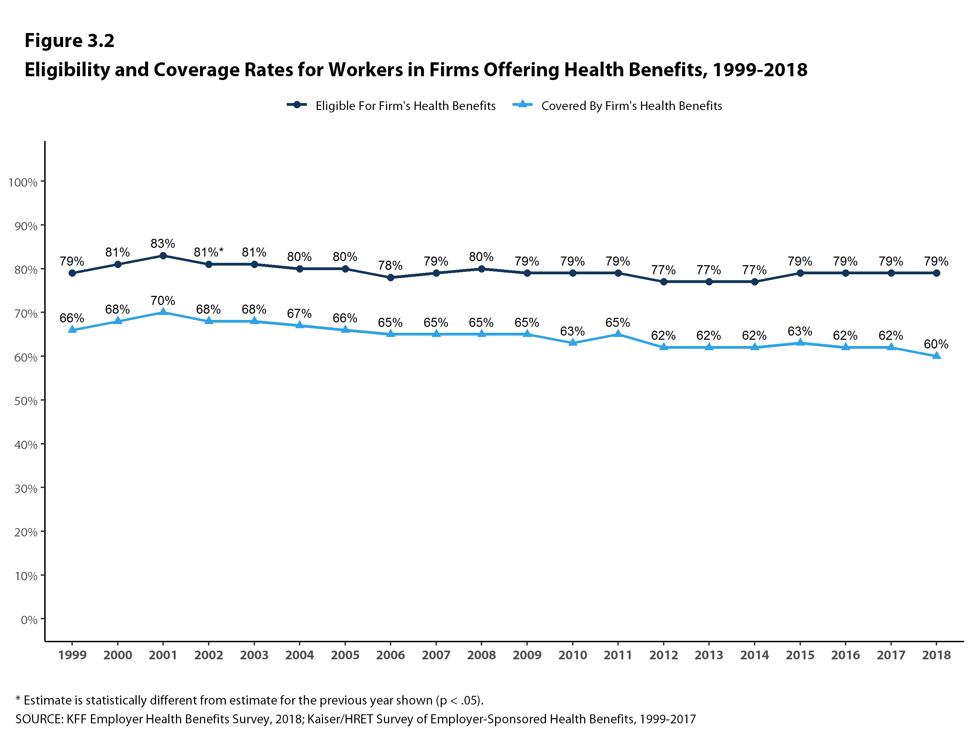
Figure 16

Slide 18
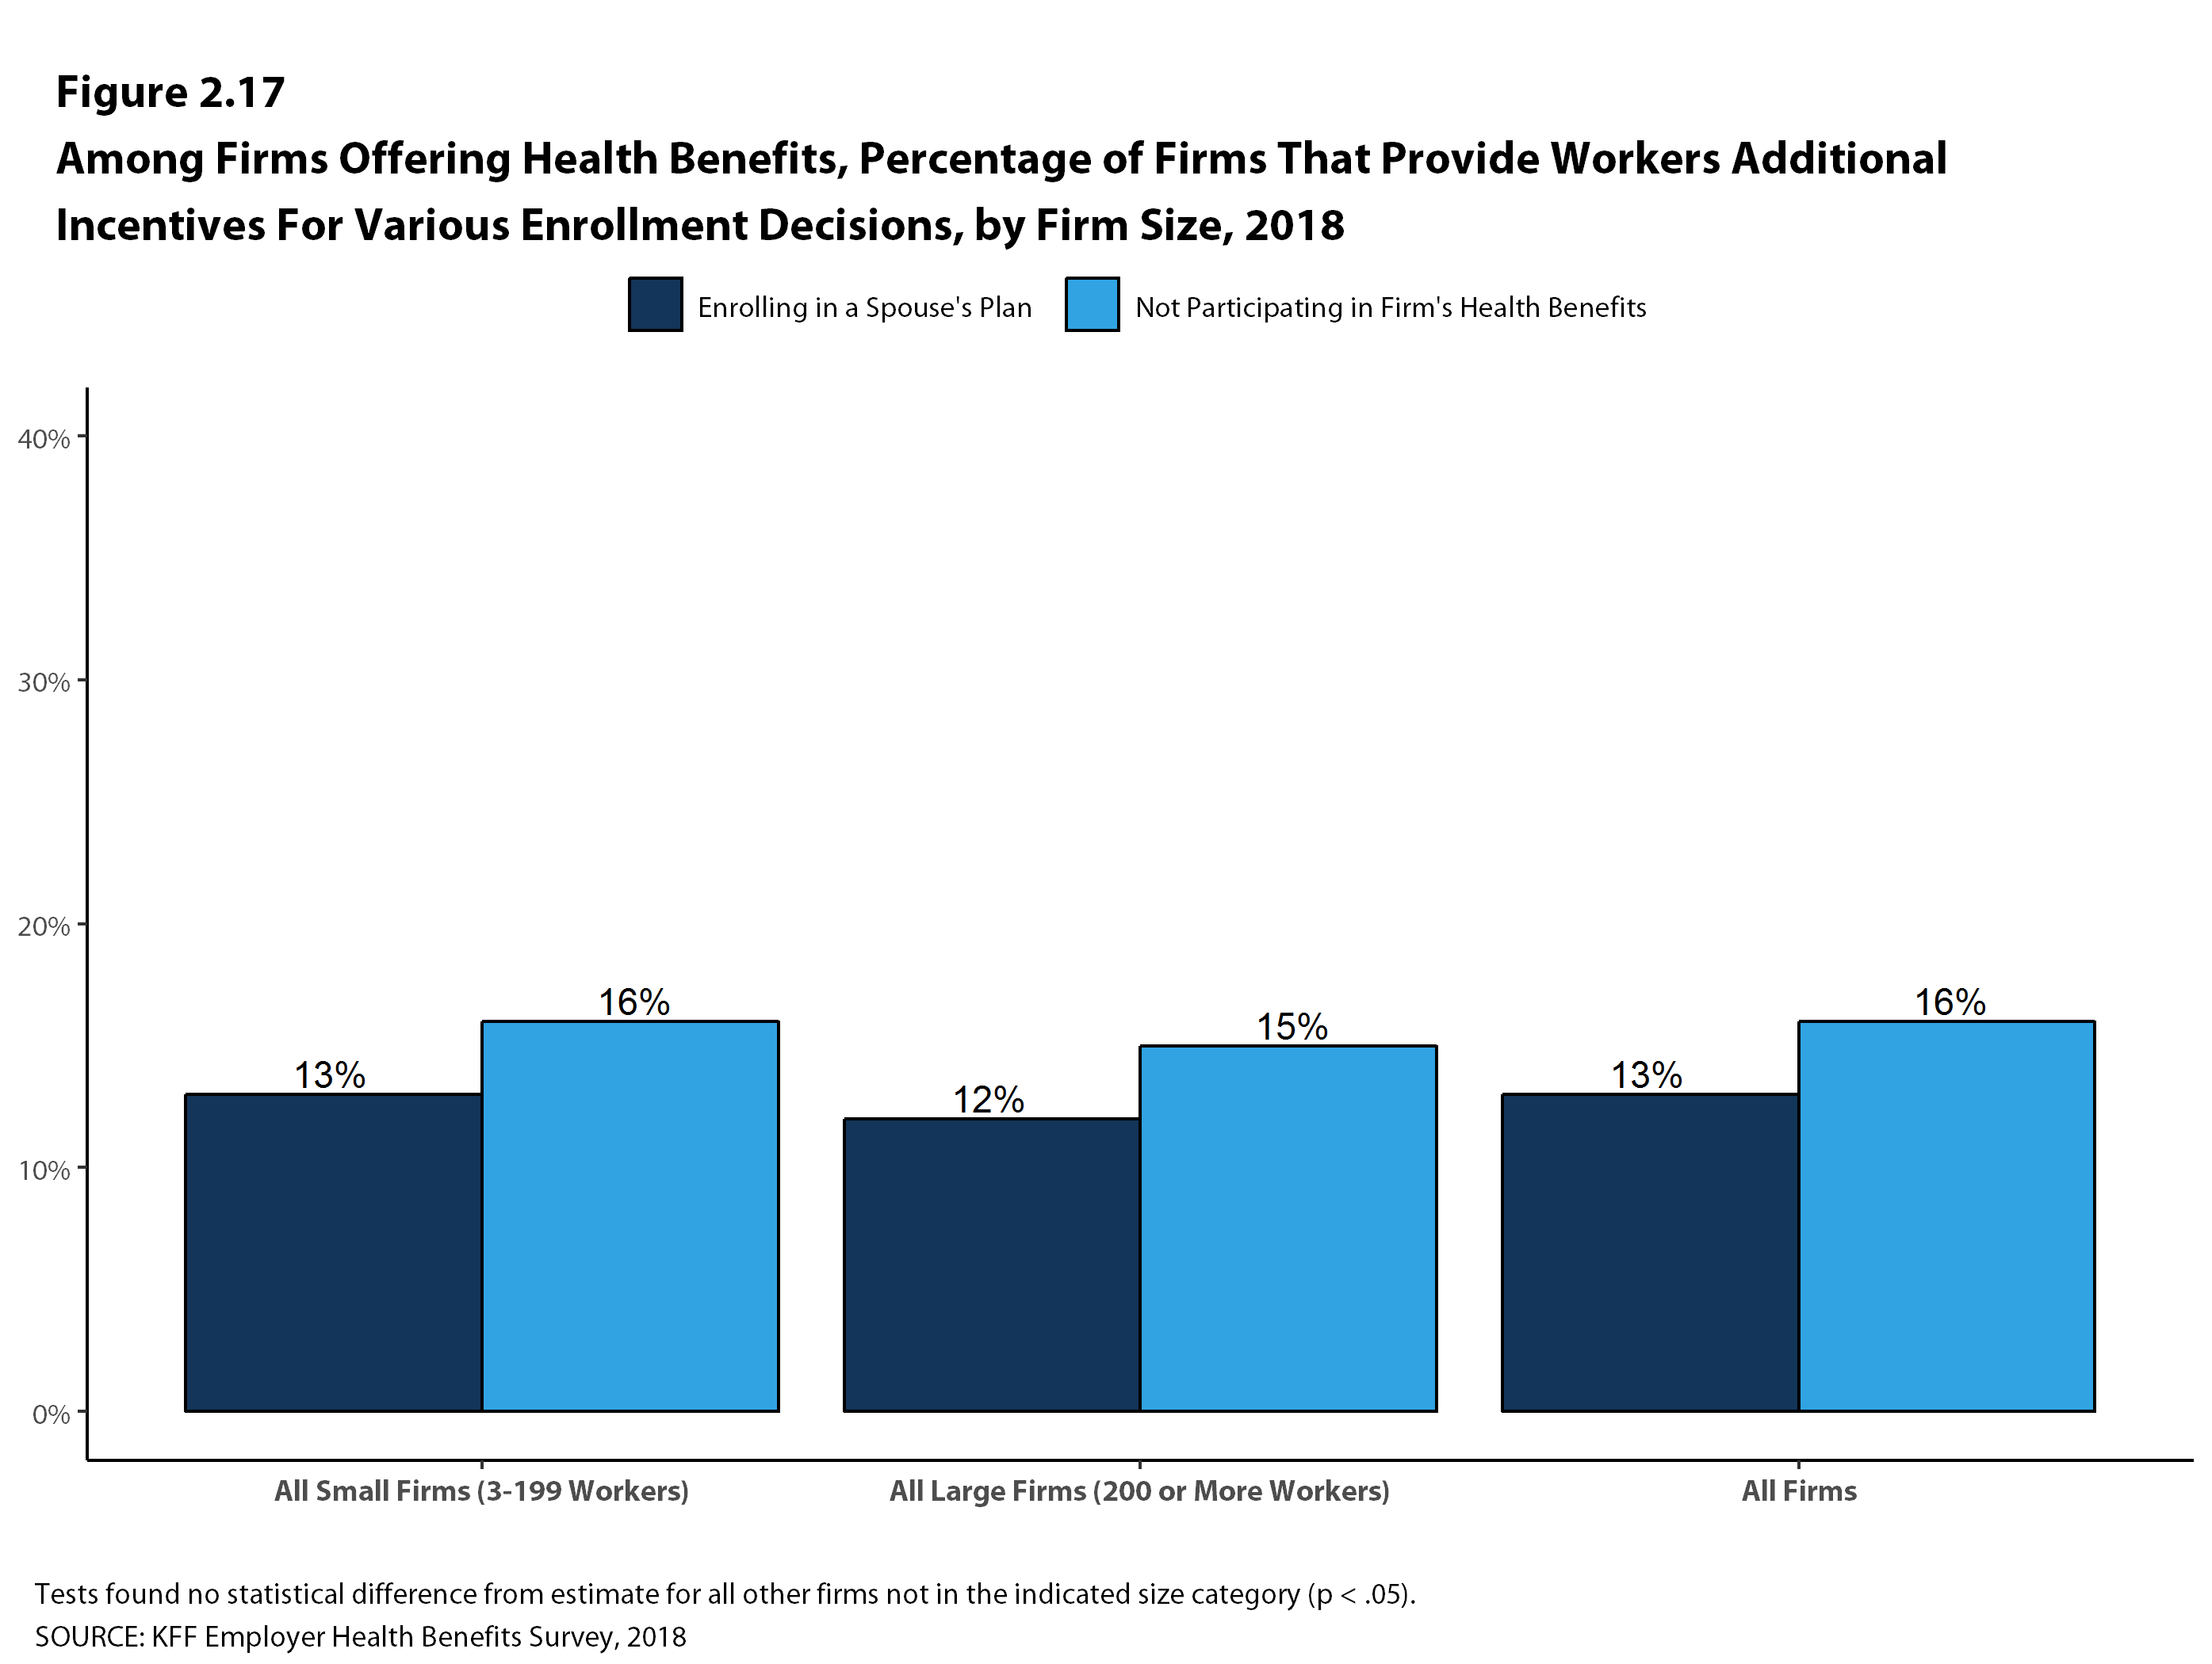
Figure 17

Slide 19
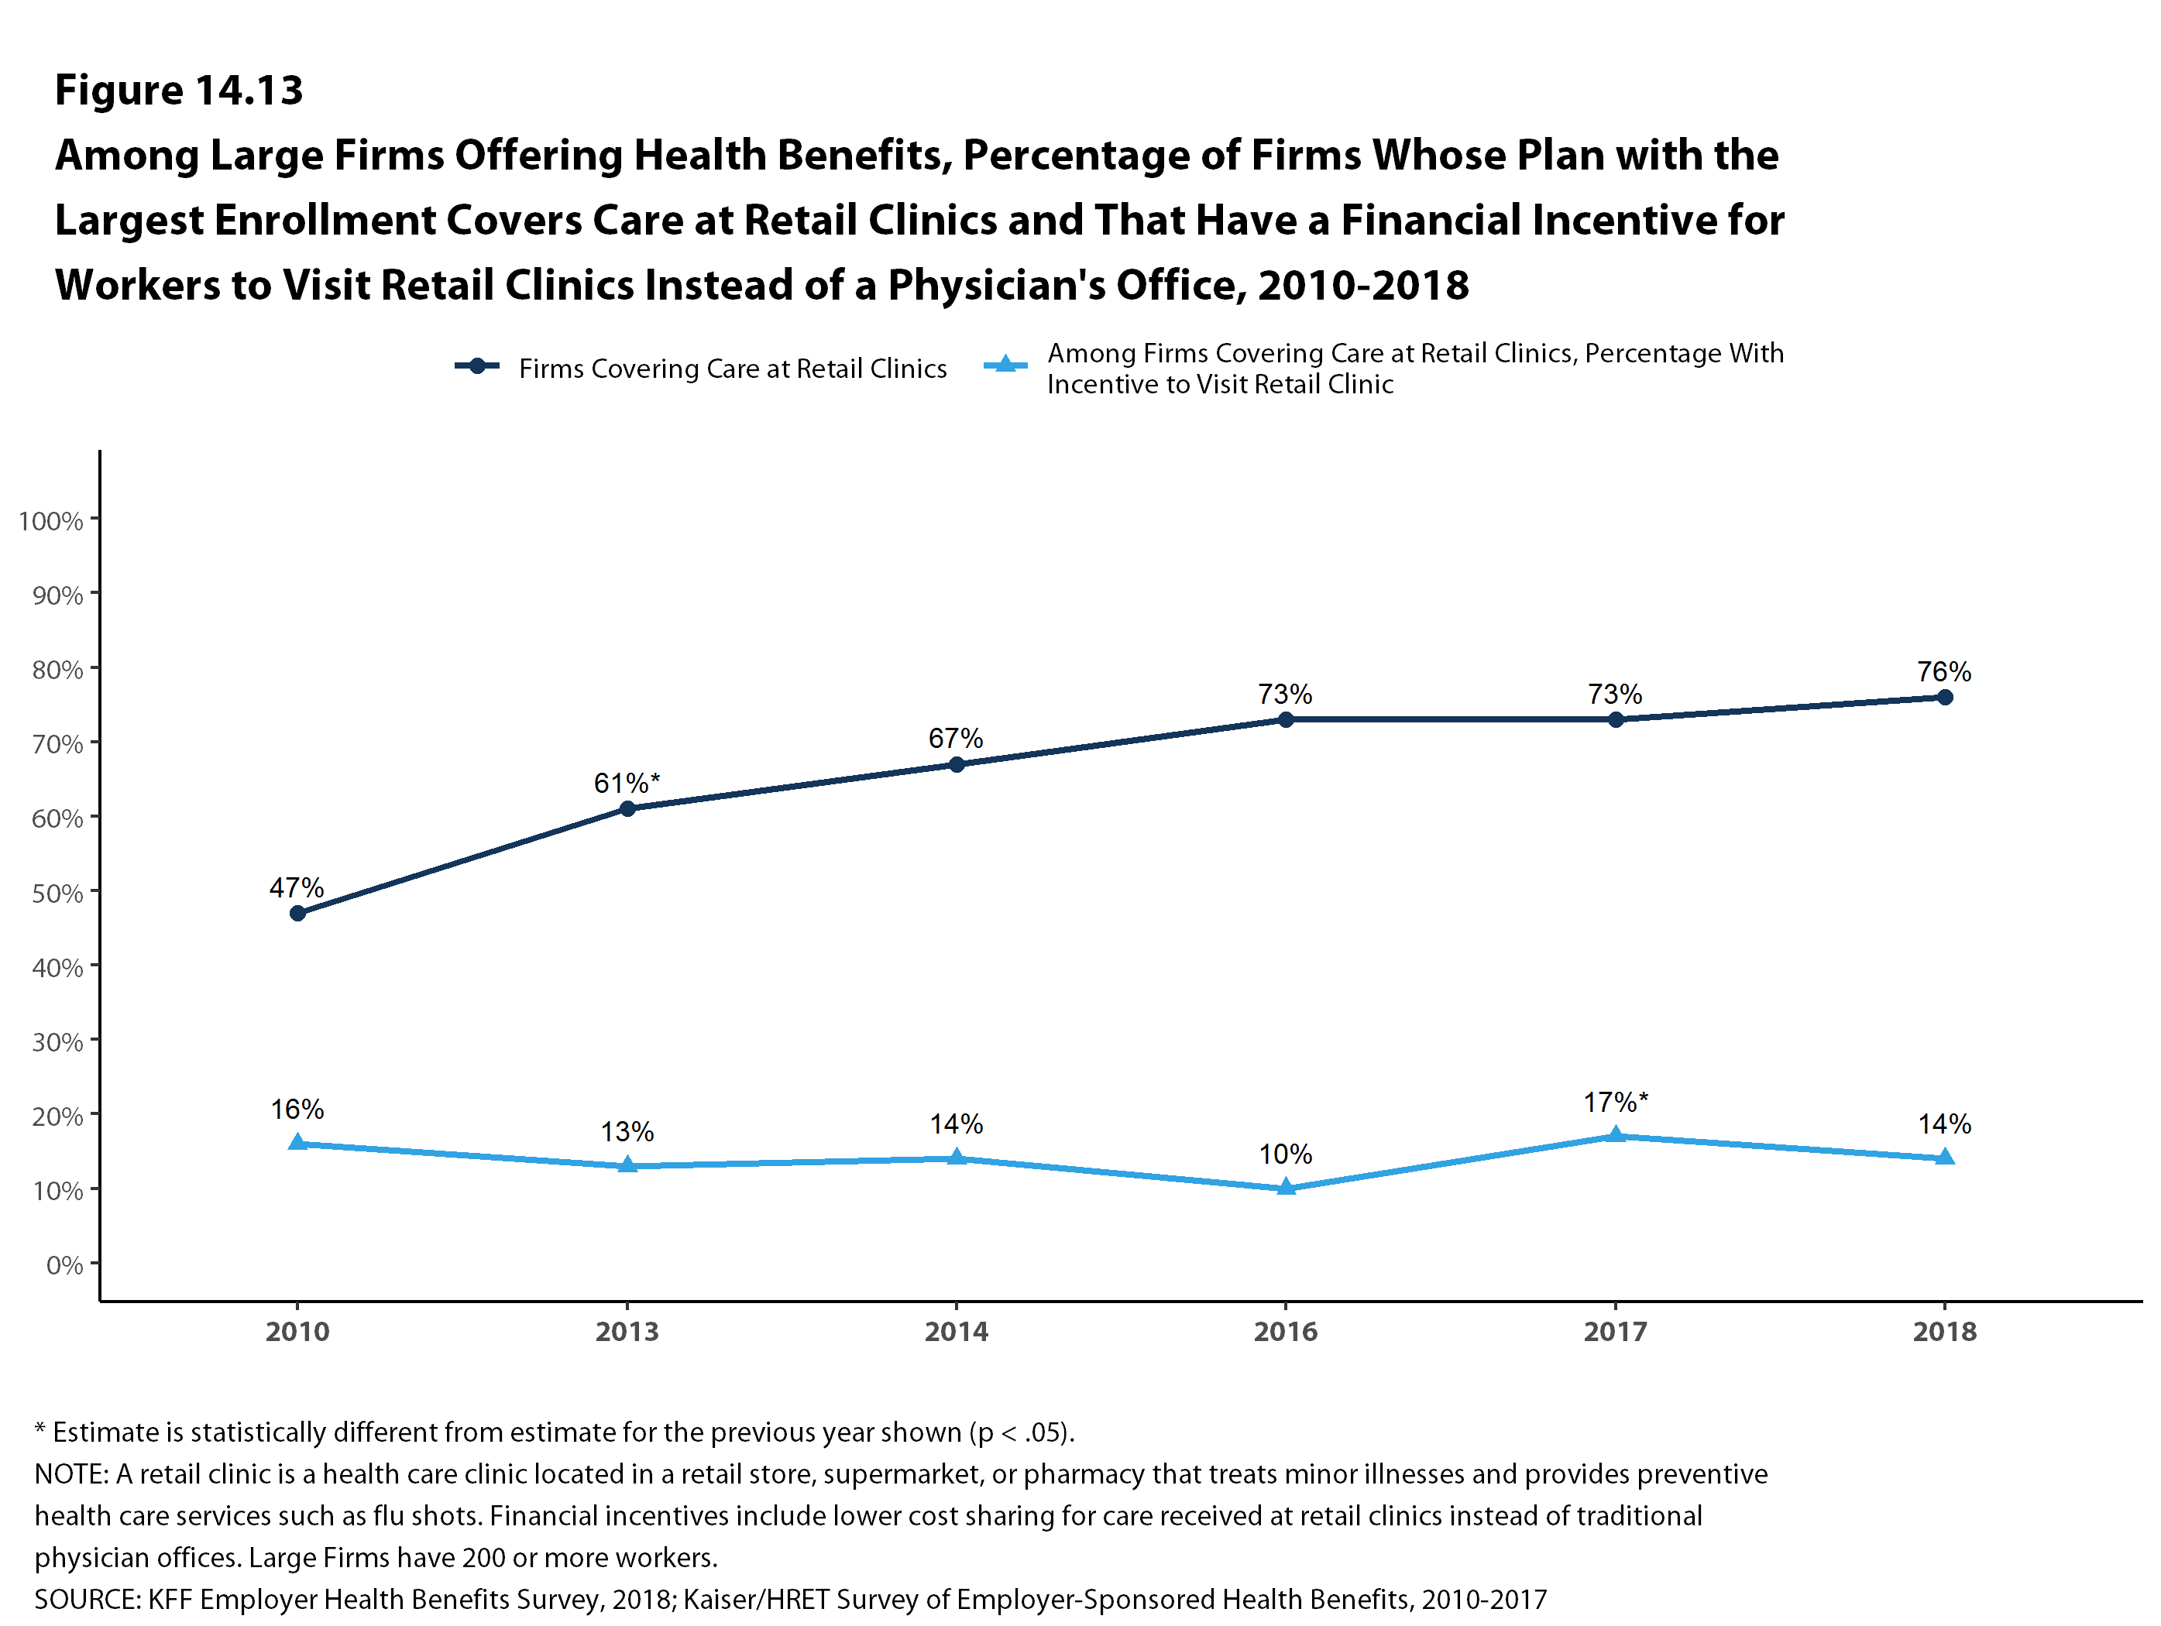
Figure 22
Figure 18

Slide 20
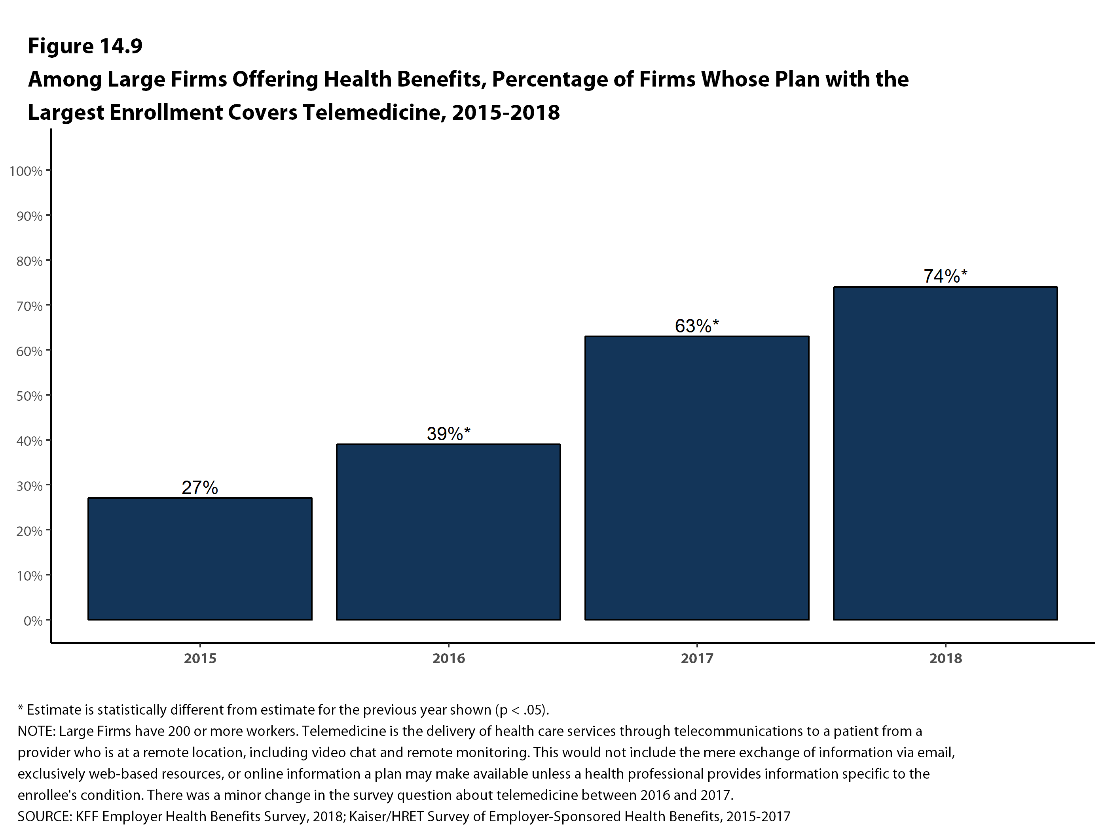
Figure 22
Figure 19

Slide 21
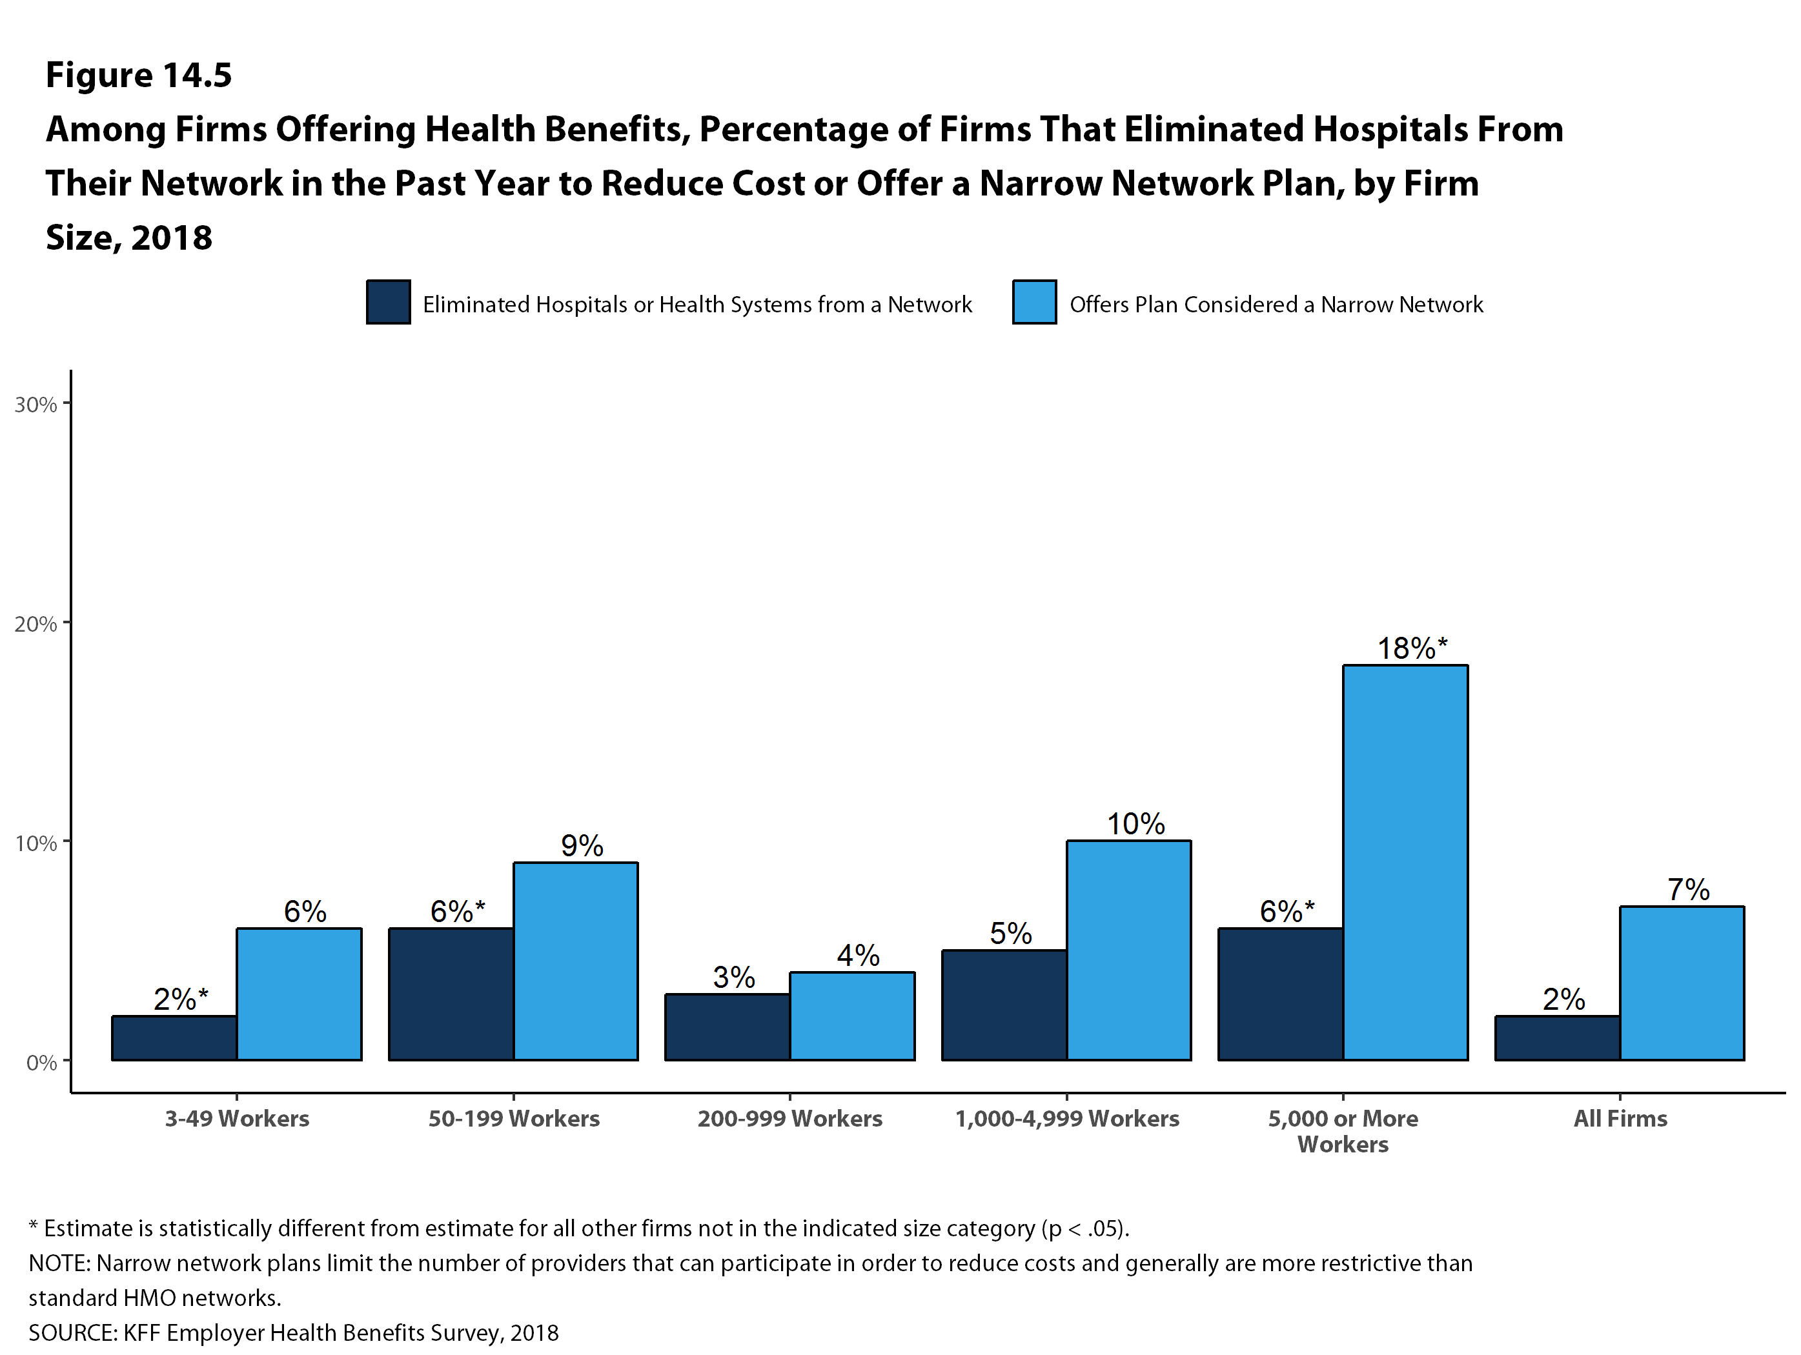
Figure 20

Slide 22
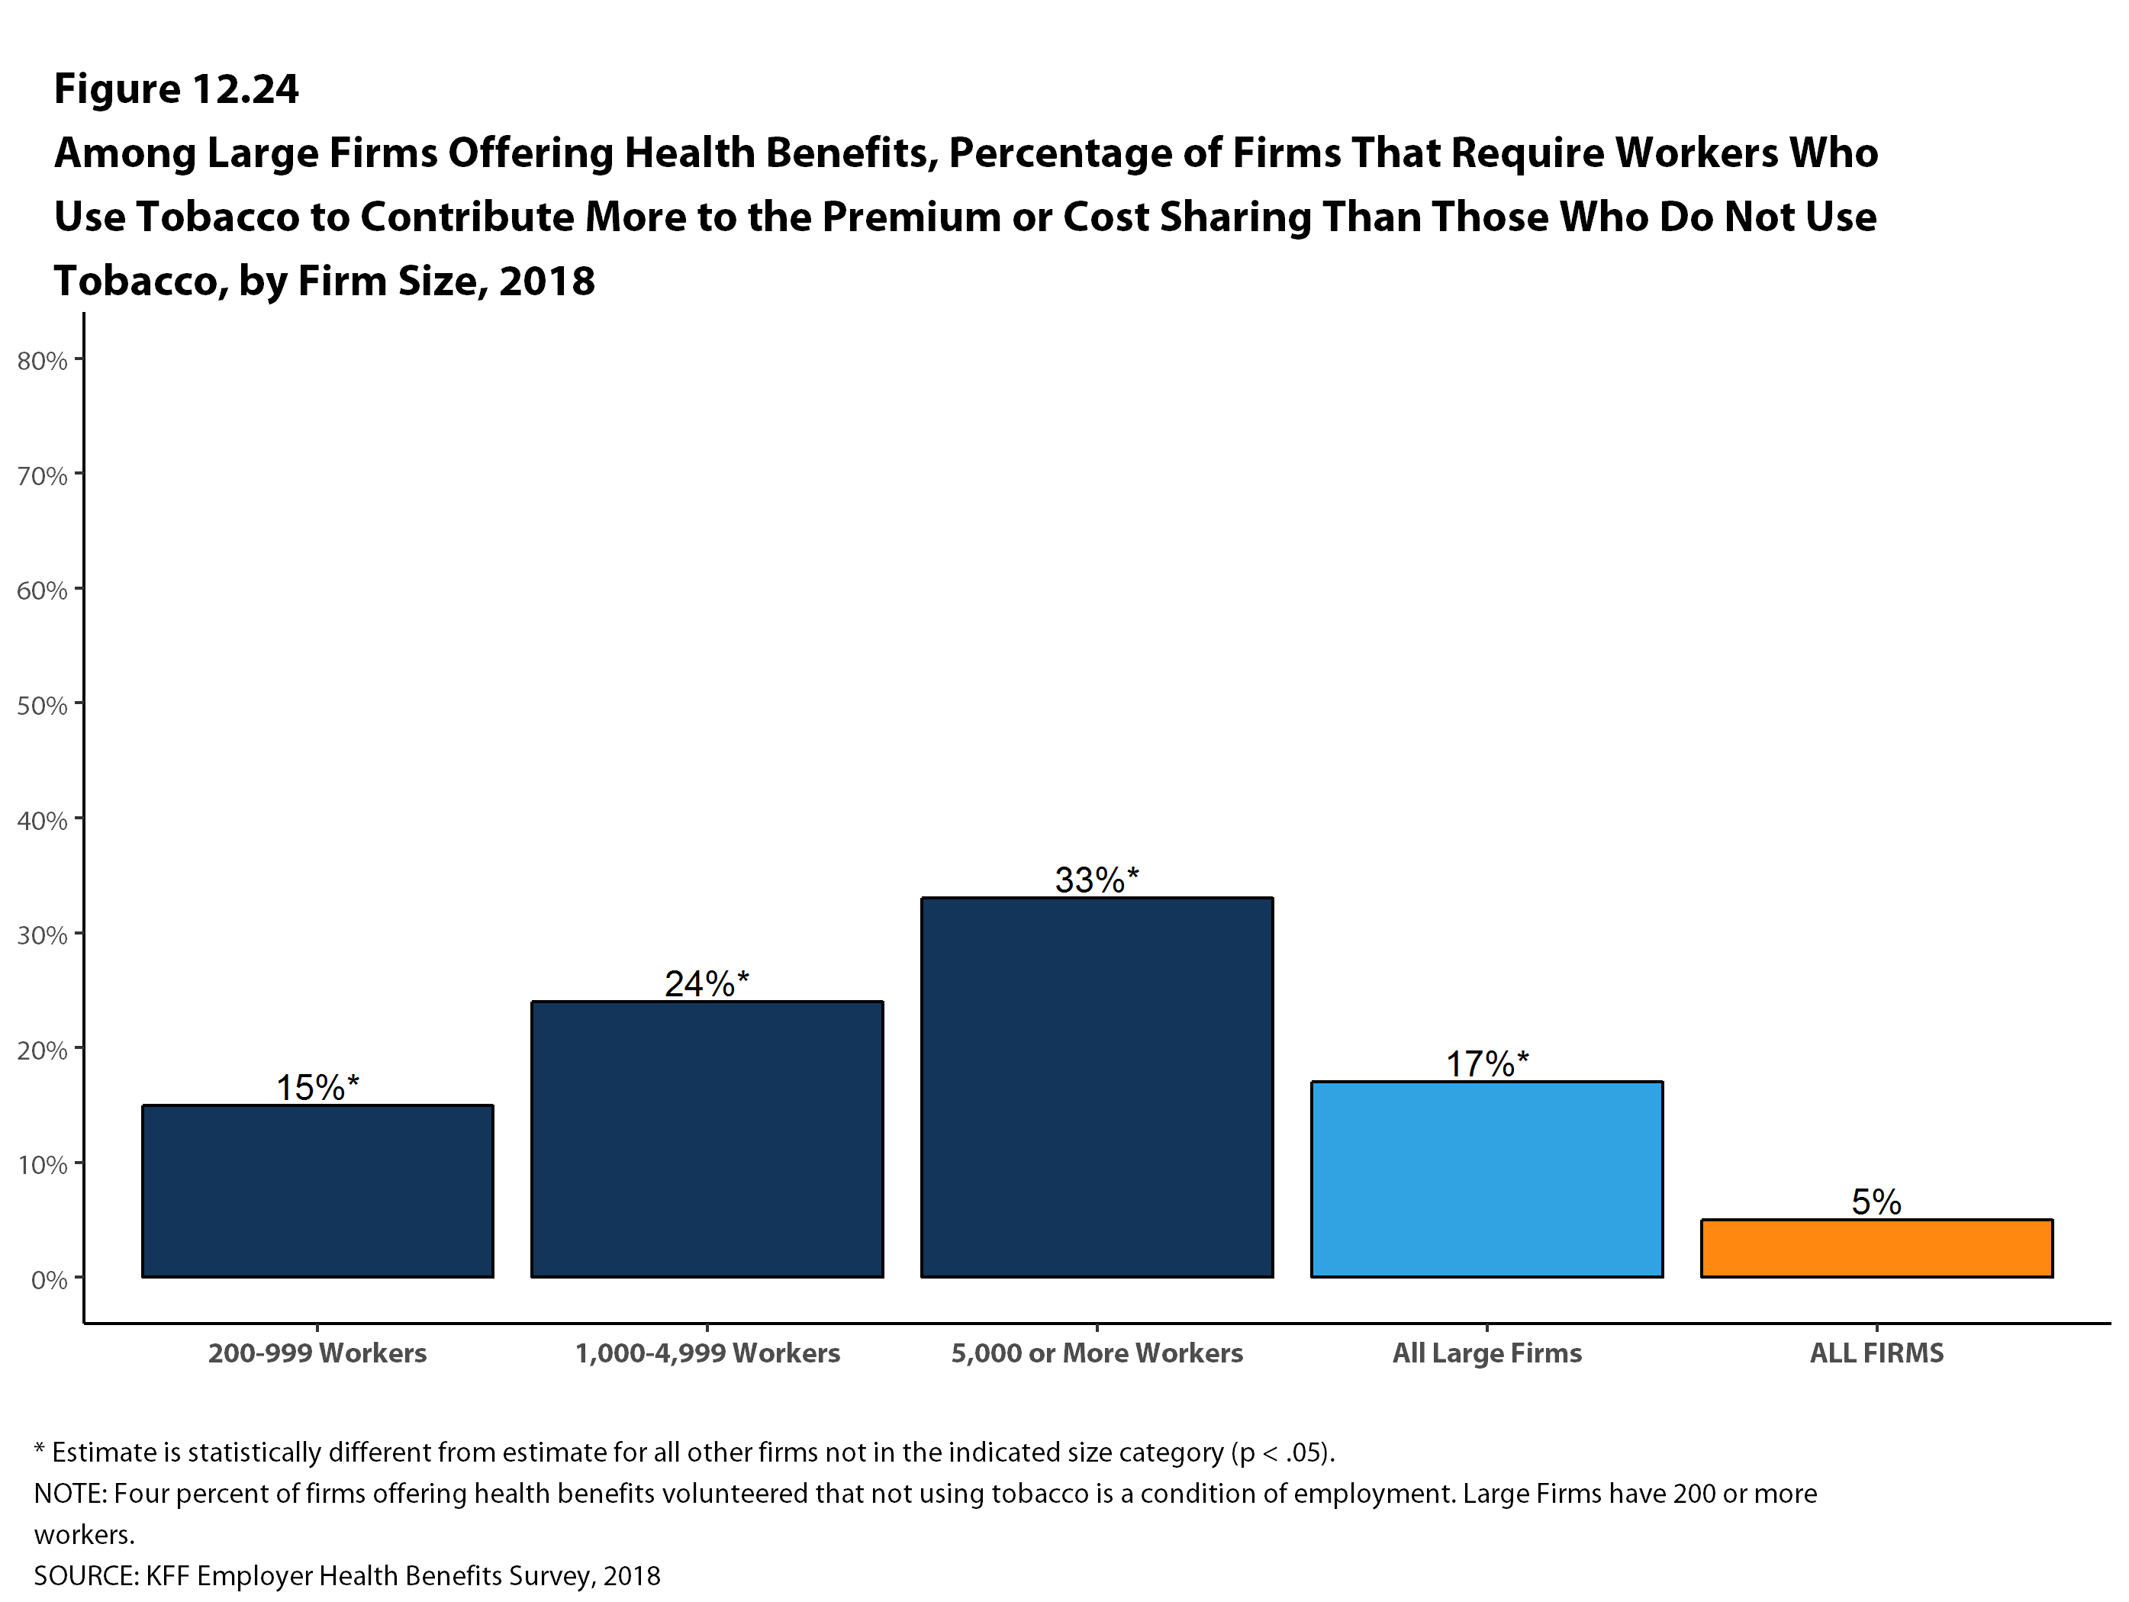
Figure 22
Figure 21

Slide 23
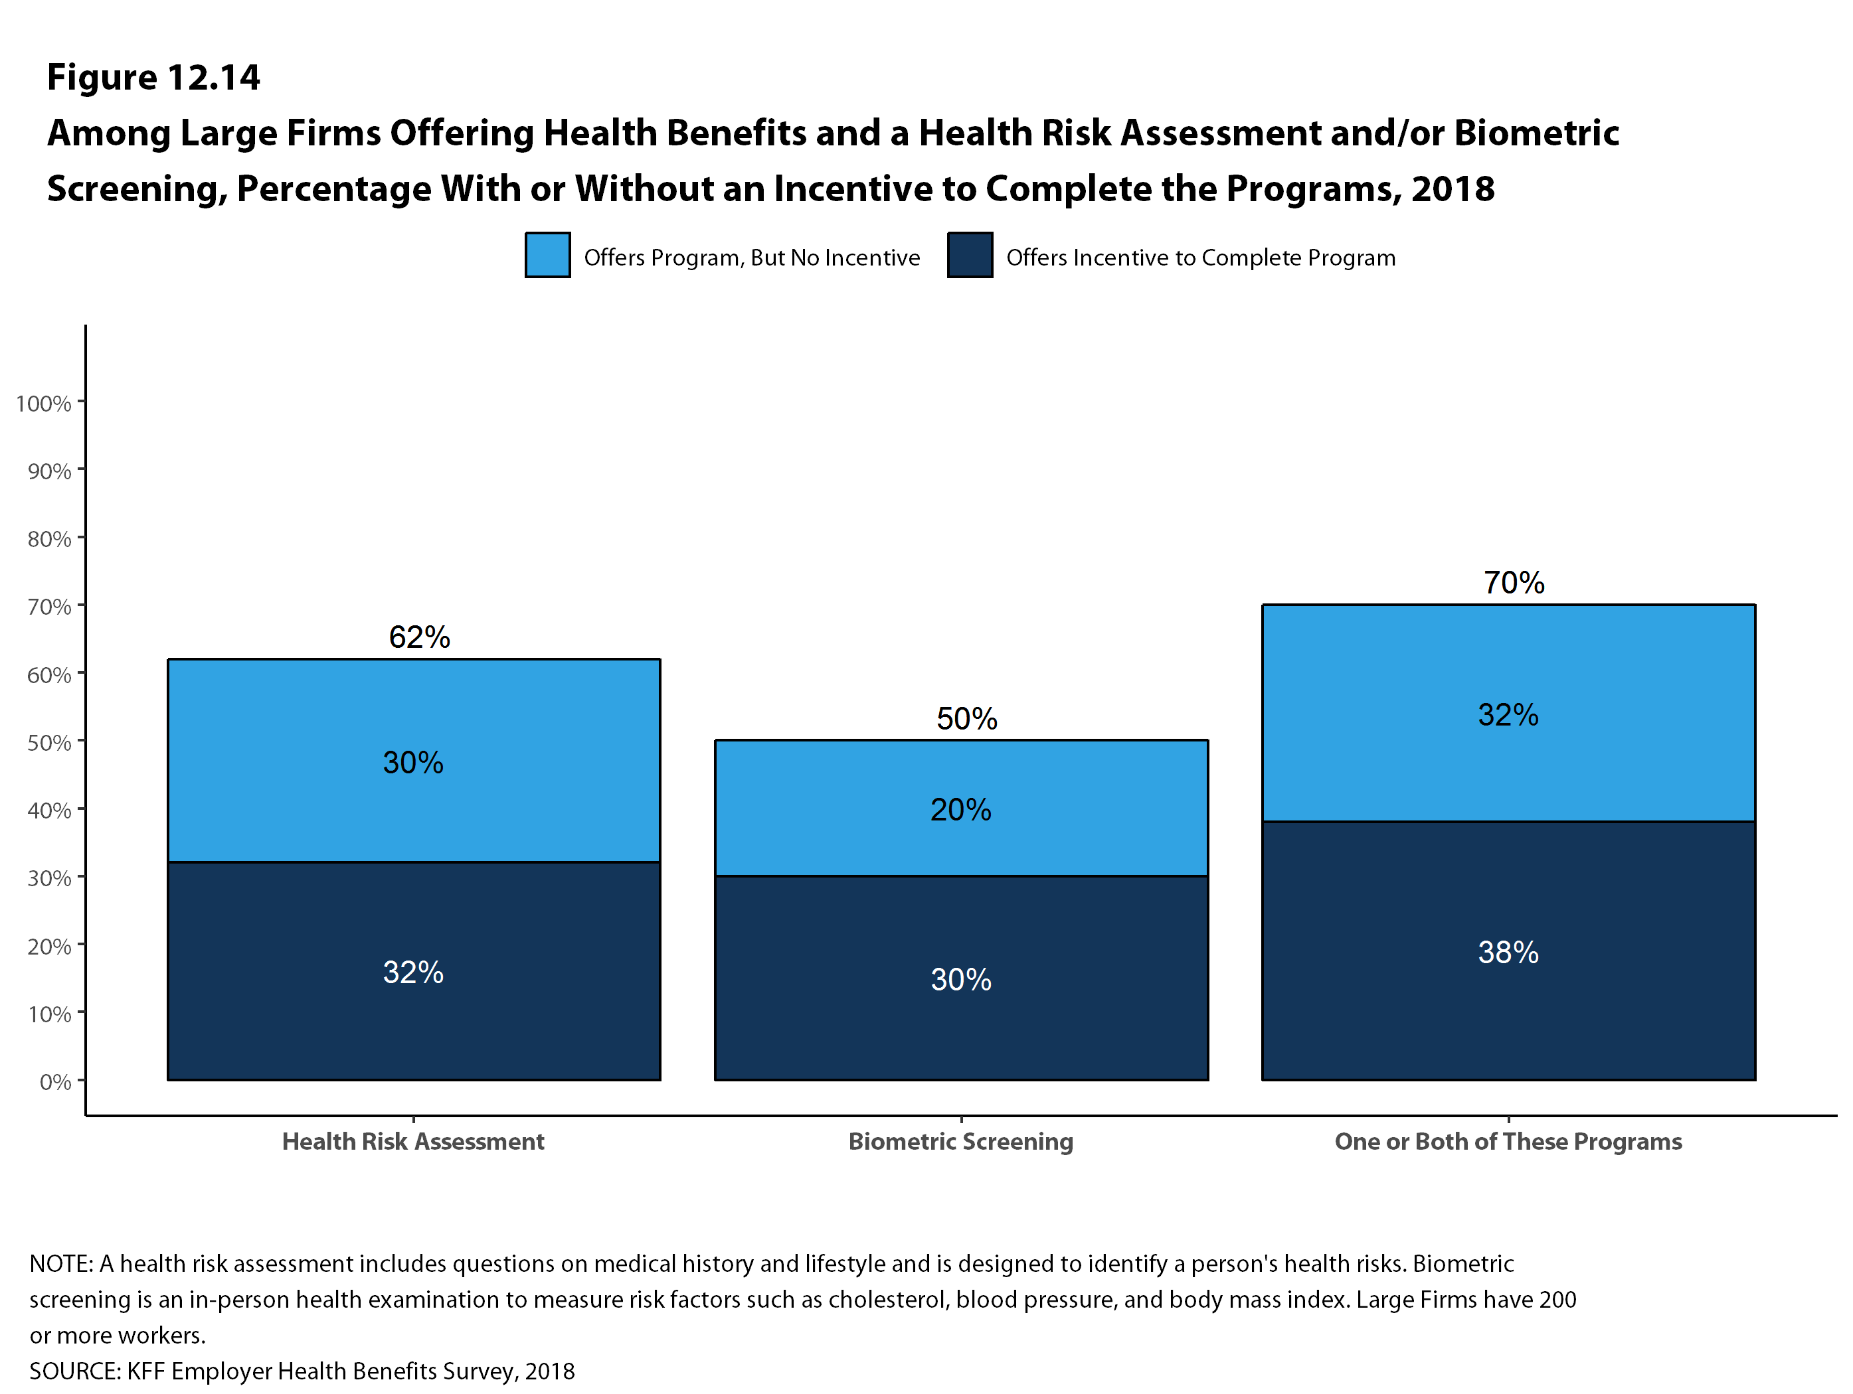
Figure 22
Figure 22

Slide 24
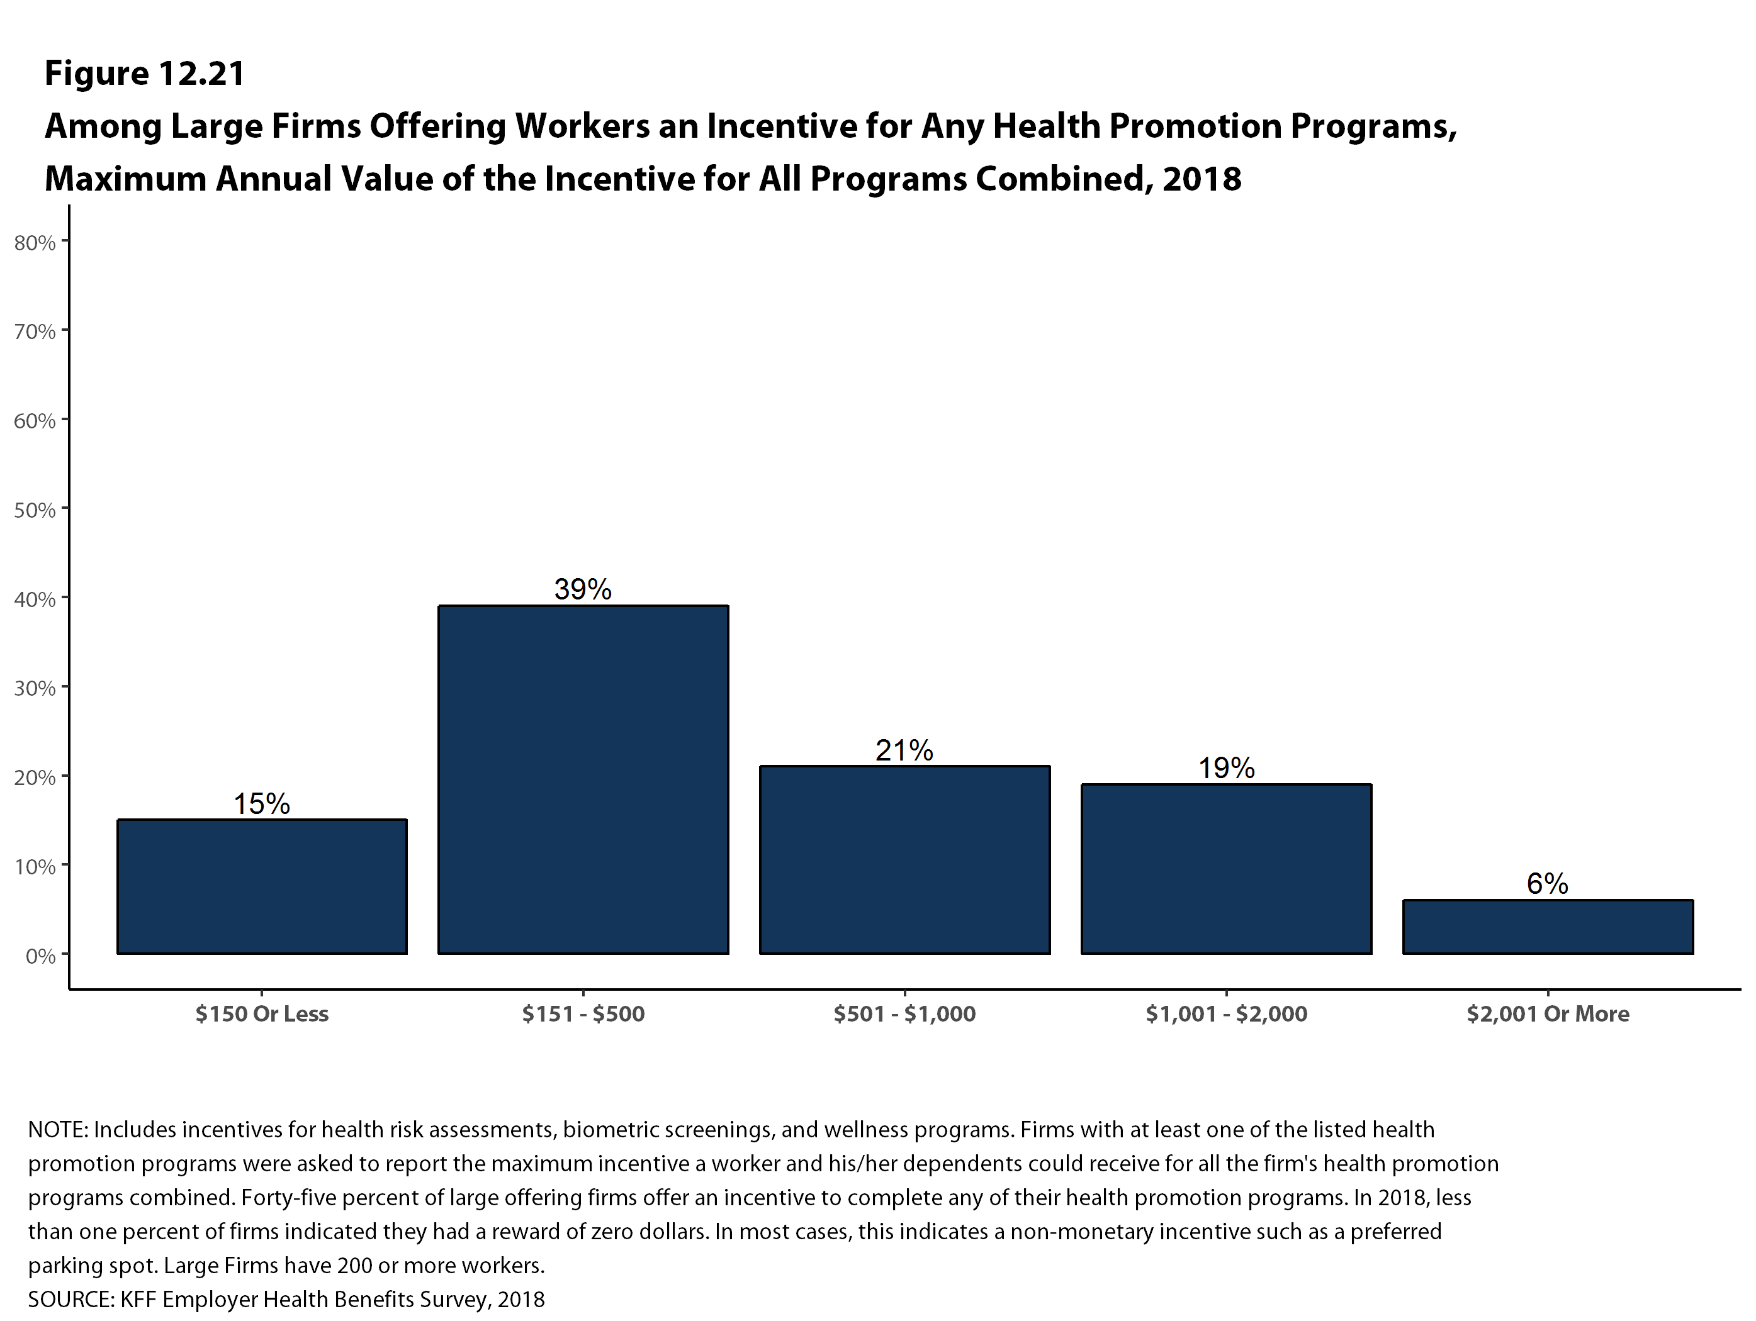
Figure 22
Figure 23

Slide 25
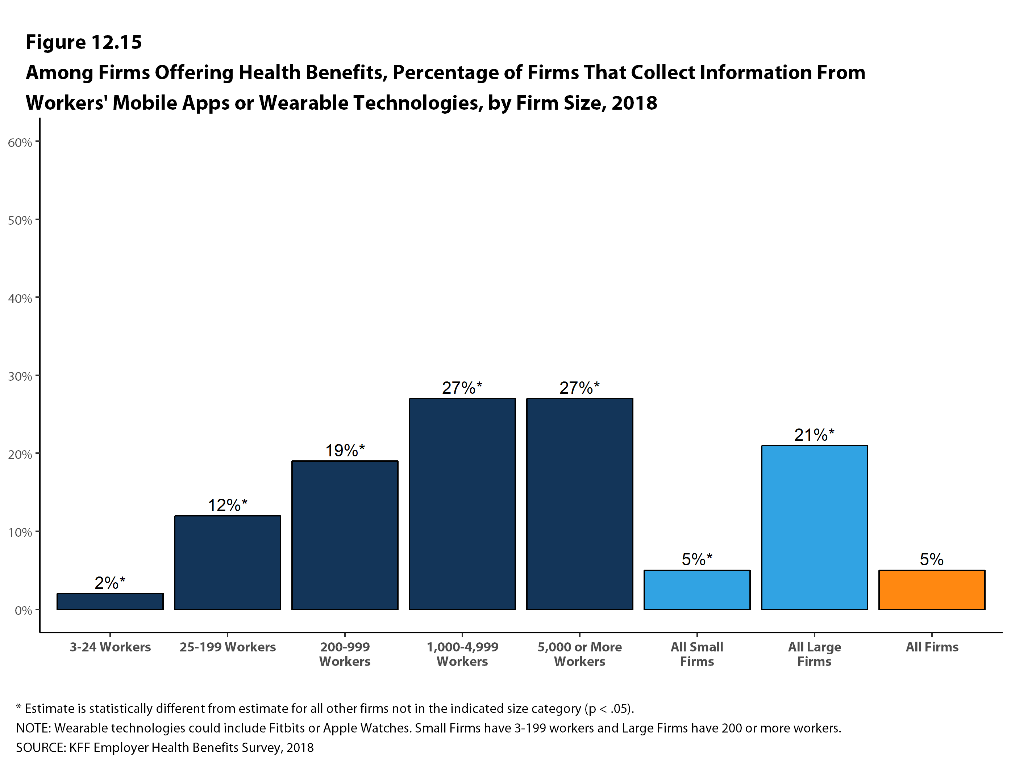
Figure 22
Figure 24

Slide 26
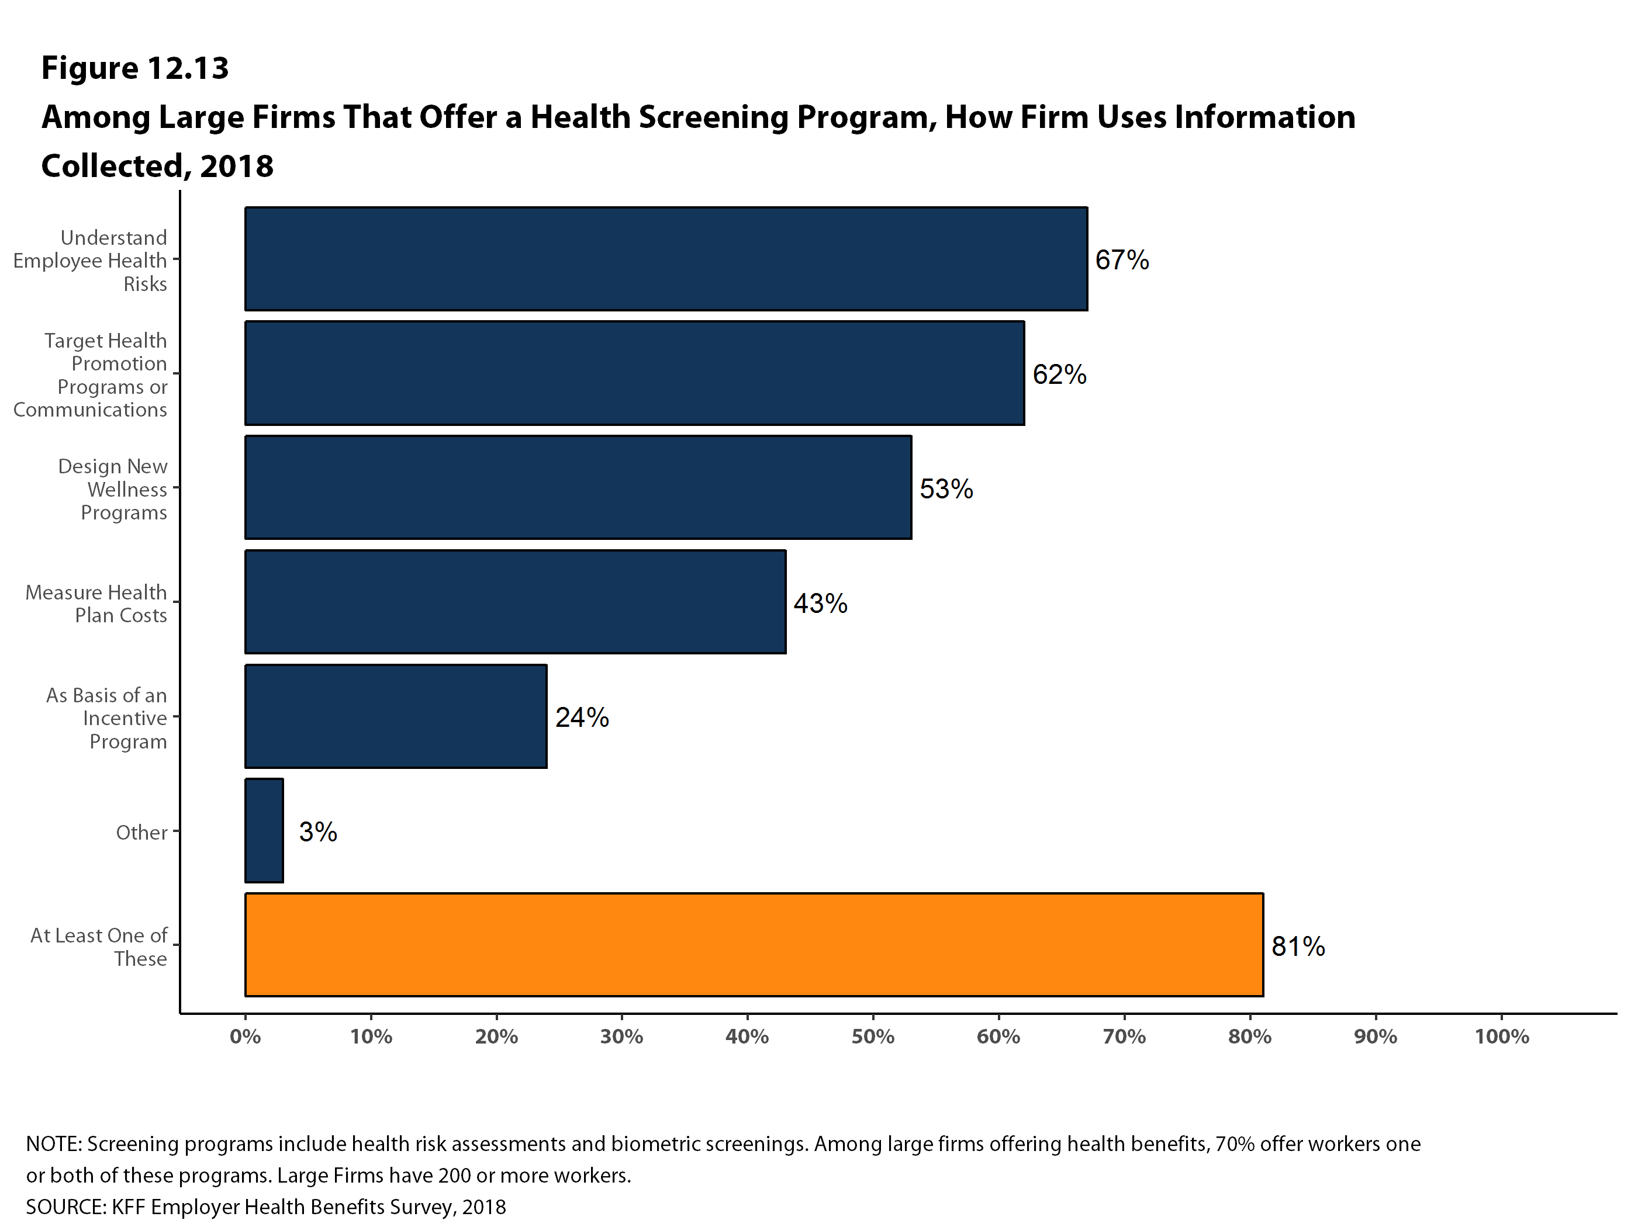
Figure 22
Figure 25

Slide 27
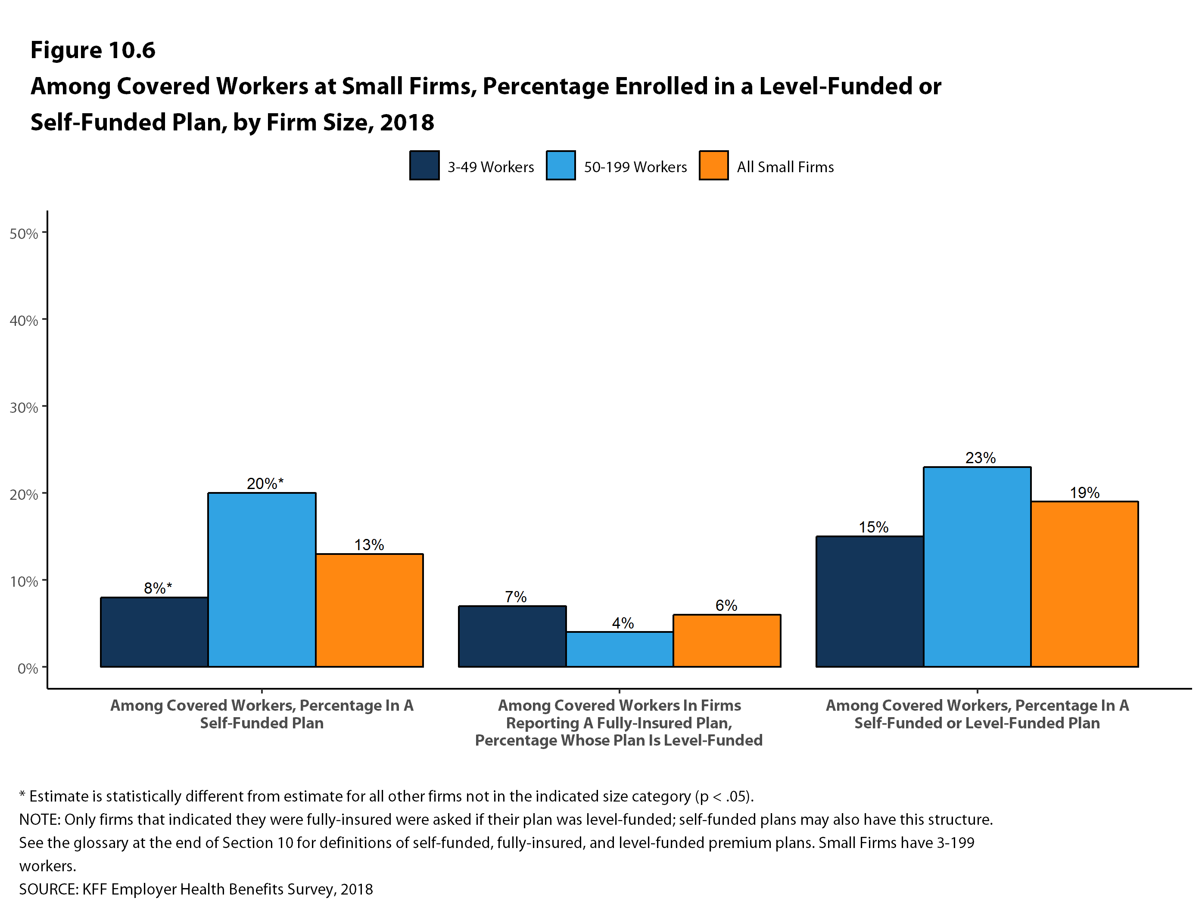
Figure 22
Figure 26

Slide 28
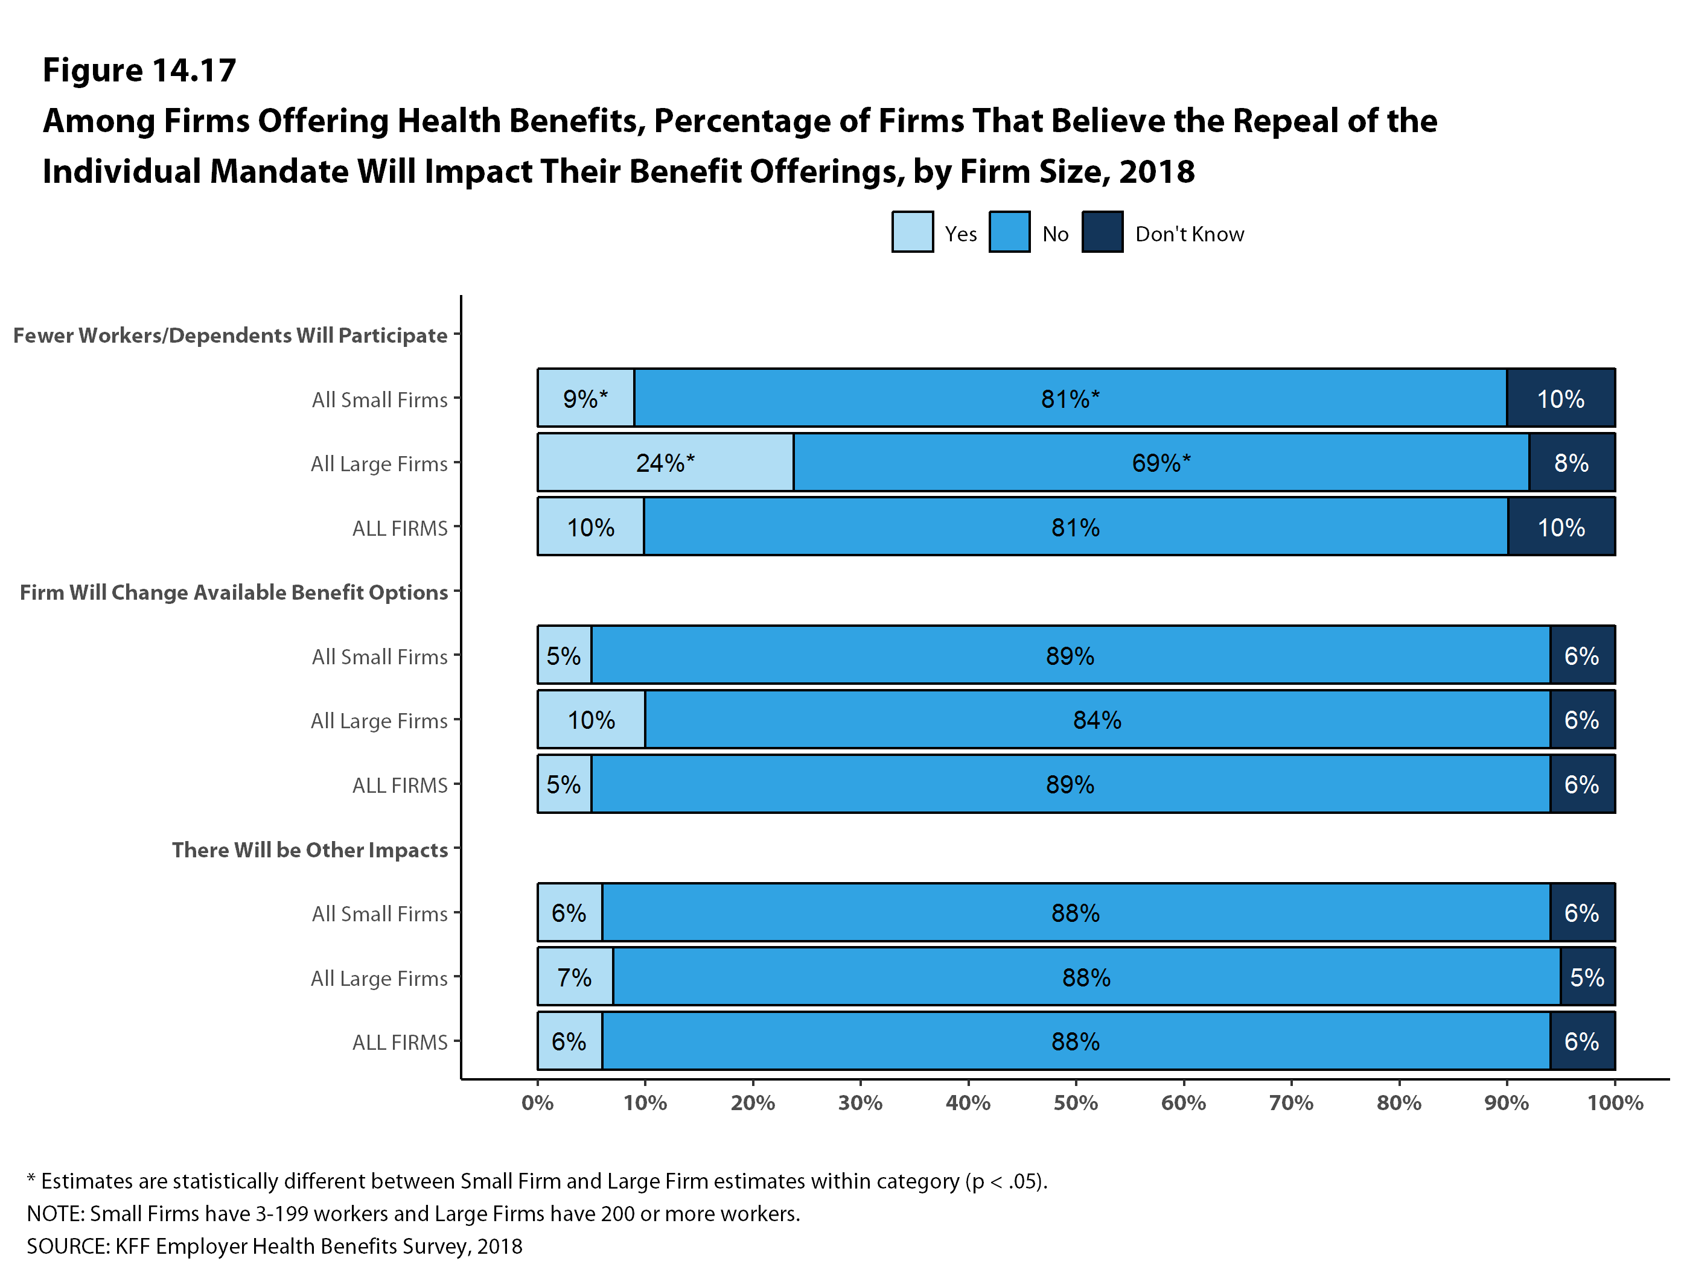
Figure 22
Figure 27

