Slide 1
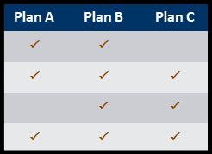



Automated Eligibility Processes Facilitate Enrollment into Coverage Through the Exchange or Public Coverage
Medicaid/CHIP
John Doe
123 Main Street
12345
Health Coverage
Premium Tax
Credits
Unsubsidized
Exchange Coverage
Single Door to Health Coverage
Eligibility for Multiple Programs Determined in
Real Time
Information Provided
on Available Plans
for Comparison
Enrollment Into Selected Plan

