Slide 1

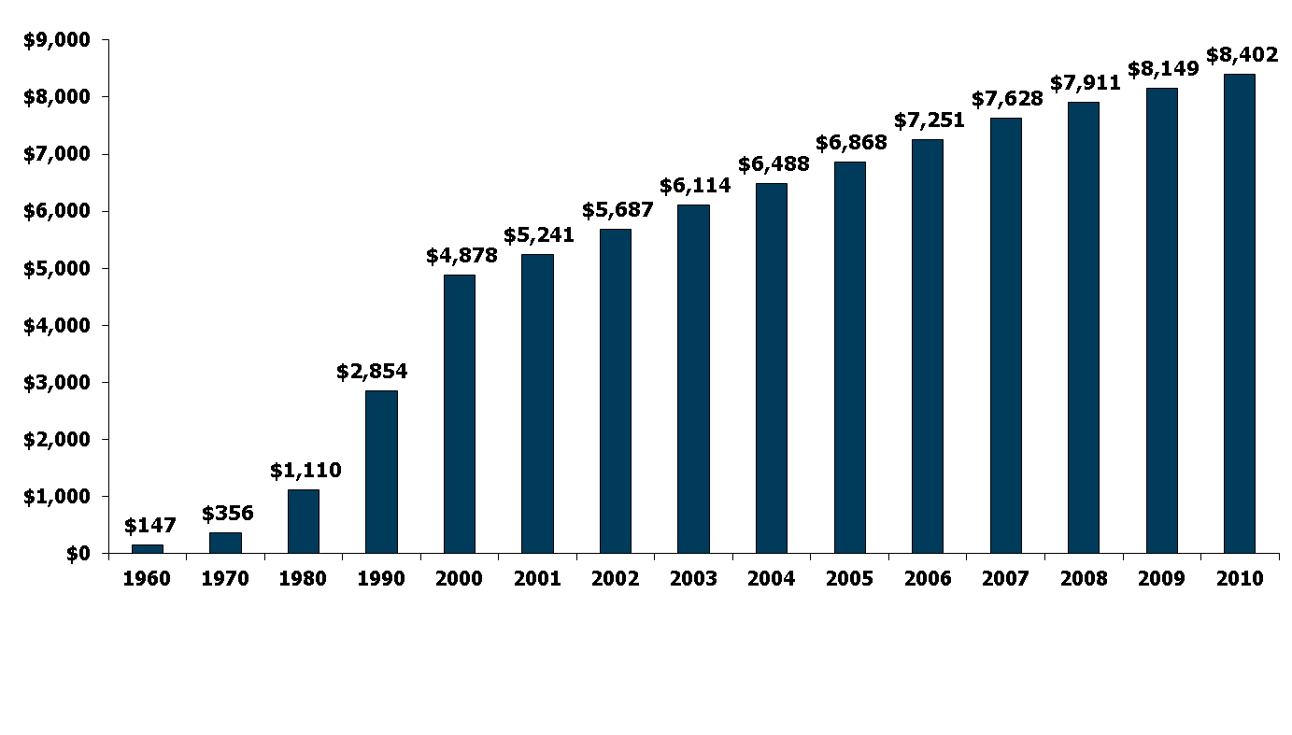
National Health Expenditures per Capita, 1960-2010
NHE as a Share of GDP
5.2% 7.2% 9.2% 12.5% 13.8% 14.5% 15.4% 15.9% 16.0% 16.1% 16.2% 16.4% 16.8% 17.9% 17.9%
Notes: According to CMS, population is the U.S. Bureau of the Census resident-based population, less armed forces overseas and population of outlying areas, plus the net undercount.
Source: Centers for Medicare and Medicaid Services, Office of the Actuary, National Health Statistics Group, at http://www.cms.hhs.gov/NationalHealthExpendData/ (see Historical; NHE summary including share of GDP, CY 1960-2010; file nhegdp10.zip).

Slide 2
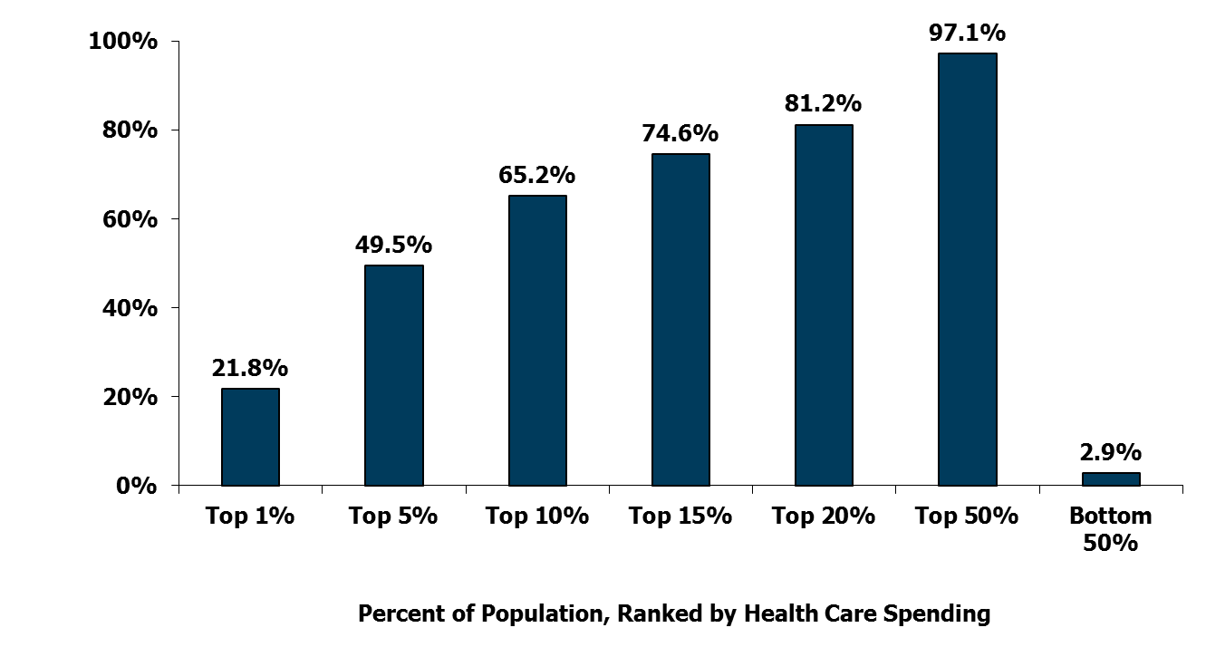
Concentration of Health Care Spending in the U.S. Population, 2009
Percent of Total Health Care Spending
(≥$51,951)
(≥$17,402)
(≥$9,570)
(≥$6,343)
(≥$4,586)
(≥$851)
(<$851)
Note: Dollar amounts in parentheses are the annual expenses per person in each percentile. Population is the civilian noninstitutionalized population, including those without any health care spending. Health care spending is total payments from all sources (including direct payments from individuals and families, private insurance, Medicare, Medicaid, and miscellaneous other sources) to hospitals, physicians, other providers (including dental care), and pharmacies; health insurance premiums are not included.
Source: Kaiser Family Foundation calculations using data from U.S. Department of Health and Human Services, Agency for Healthcare Research and Quality, Medical Expenditure Panel Survey (MEPS), Household Component, 2009.

Slide 3

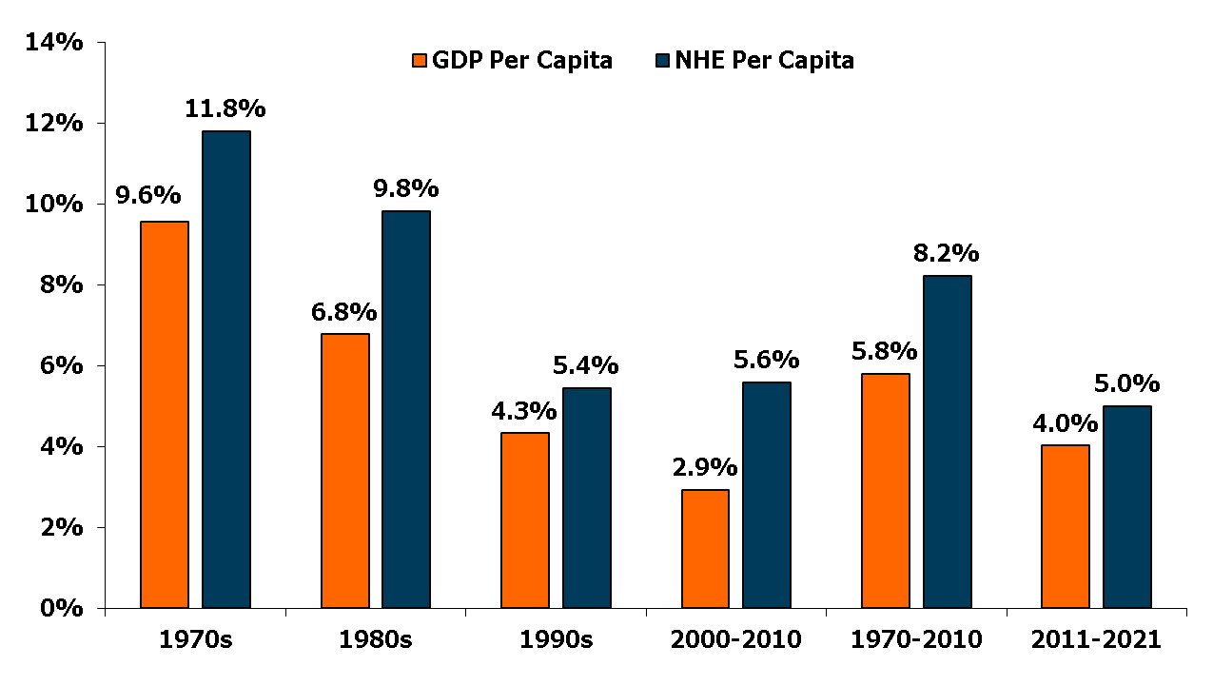
Average Annual Growth Rates for Health Spending and GDP Per Capita
Plus 2.4
Plus 1.0
Projected
Source: Historical data from Centers for Medicare and Medicaid Services, Office of the Actuary, National Health Statistics Group.

Slide 4
Putting Off Care Because of Cost
Percent who say they or another family member living in their household have done each of the following because of the cost:
Relied on home remedies or over-the-counter drugs instead of going to see a doctor
Skipped dental care or checkups
Put off or postponed getting health care needed
Not filled a prescription for a medicine
Skipped a recommended medical test or treatment
Cut pills in half or skipped doses of medicine
Had problems getting mental health care
‘Yes’ to any of the above
Source: Kaiser Family Foundation Health Tracking Poll (conducted May 8-14, 2012).

Slide 5
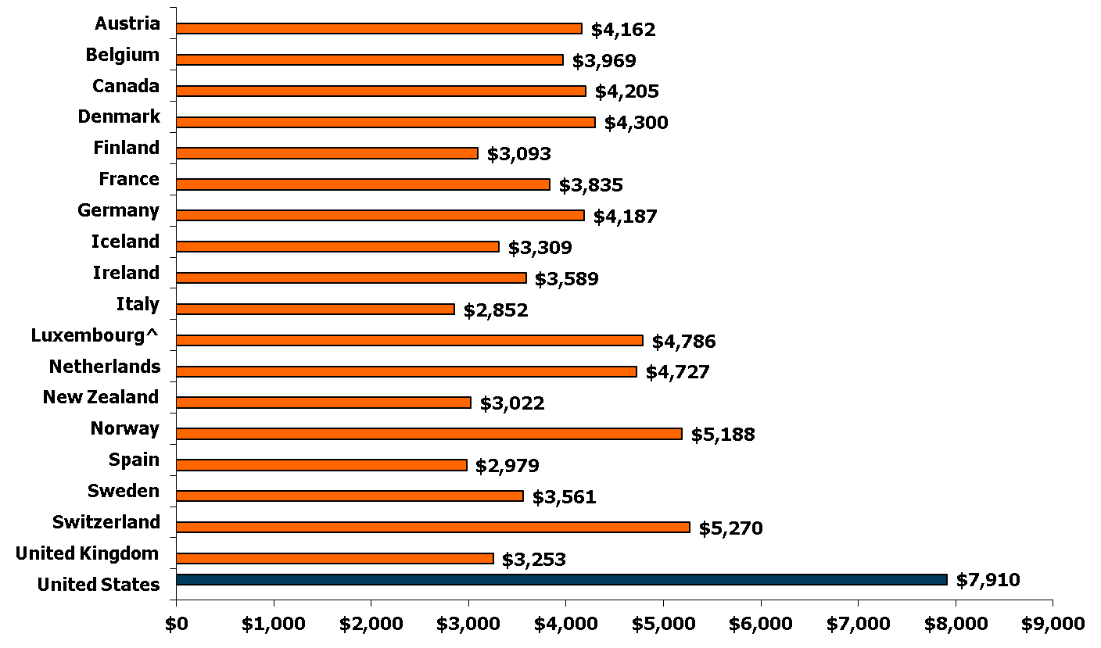
Per Capita Total Current Health Care Expenditures, U.S. and Selected Countries, 2010
^ 2009 data
Notes: Amounts in U.S.$ Purchasing Power Parity, see www.oecd.org/std/ppp; includes only countries over $2,500. OECD defines Total Current Expenditures on Health as the sum of expenditures on personal health care, preventive and public health services, and health administration and health insurance; it excludes investment.
Source: Organisation for Economic Co-operation and Development. “OECD Health Data: Health Expenditures and Financing”, OECD Health Statistics Data from internet subscription database. http://www.oecd-library.org, data accessed on 08/23/12.

Slide 6
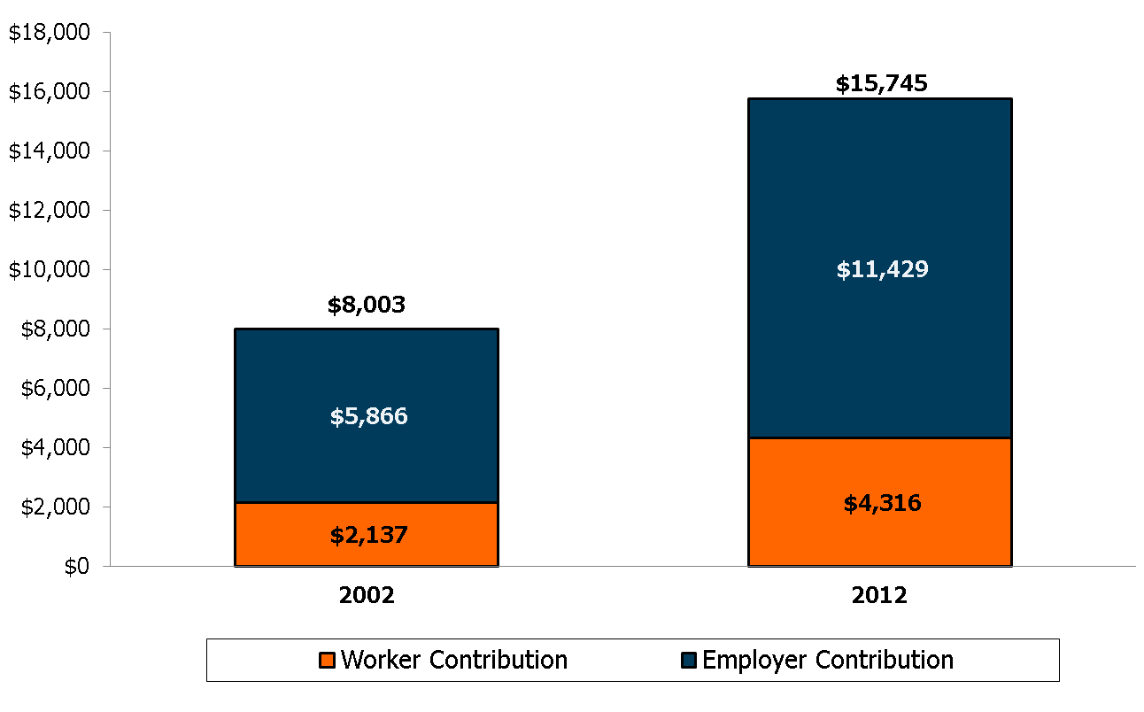
Average Annual Worker and Employer Contributions to Premiums and Total Premiums for Family Coverage
Source: Kaiser/HRET Survey of Employer-Sponsored Health Benefits, 2002-2012.

